Slide 1
Distribution System Resilience:
Hardening, Preparation and Restoration
ECpE Department
Dr. Zhaoyu Wang
Department of Electrical and Computer Engineering
Iowa State University

Slide 2




Outline
Introduction to Resilience
Pre-Event Preparation
Post-Event Outage Management and Service Restoration
Resilience-Oriented Long-Term Planning
ECpE Department

Slide 3
History of Resilience
The word resilience is found from the year 1430 in late medieval and early modern French as a juridical term for contract termination and for the restoration of the original legal situation.
In 1818, Tredgold used resilience to explain why some types of wood were able to accommodate sudden and severe loads without breaking.
In 1856, Robert Mallet further developed this concept of resilience as a means of measuring and comparing the strength of materials used in construction.
In 1973, Crawford Holling introduced the concept of resilience to ecology and the environment. He defined it as a measure of the persistence of systems and their ability to absorb change and disturbance.
ECpE Department

Slide 4
History of Resilience (cont.)
In 1977, Amory Lovins adapted Holling’s resilience concept to energy systems in his article “Resilience In Energy Strategy.”
In 2000, Neil Adger introduced resilience to social science and defined it as the ability of communities to withstand external shocks to their social infrastructure.
In 2009, the National Infrastructure Advisory Council defined critical infrastructure resilience as:
“…the ability to reduce the magnitude and/or duration of disruptive events. The effectiveness of a resilient infrastructure or enterprise depends upon its ability to anticipate, absorb, adapt to, and/or rapidly recover from a potentially disruptive event.”
ECpE Department

Slide 5
Definitions
Resilience
The ability to prepare for and adapt to changing conditions and withstand and recover rapidly from disruptions.
Reliability
The ability of the system to satisfy the customer demand within accepted standards and in the amount desired.
 | Resilience | Reliability
Events Considered | Low Probability, High Consequence Hazards | High Probability, Low Consequence Hazards
Risk-based? | Yes | No
Binary or continuous? | Resilience is considered a continuum, confidence is specified | Operationally, the system is reliable or not. Confidence is unspecified
Measurement focus | Focus is on measuring impact to humans | Focus is on measuring the impact to the system
Source: (Vugrin 2017)
ECpE Department

Slide 6
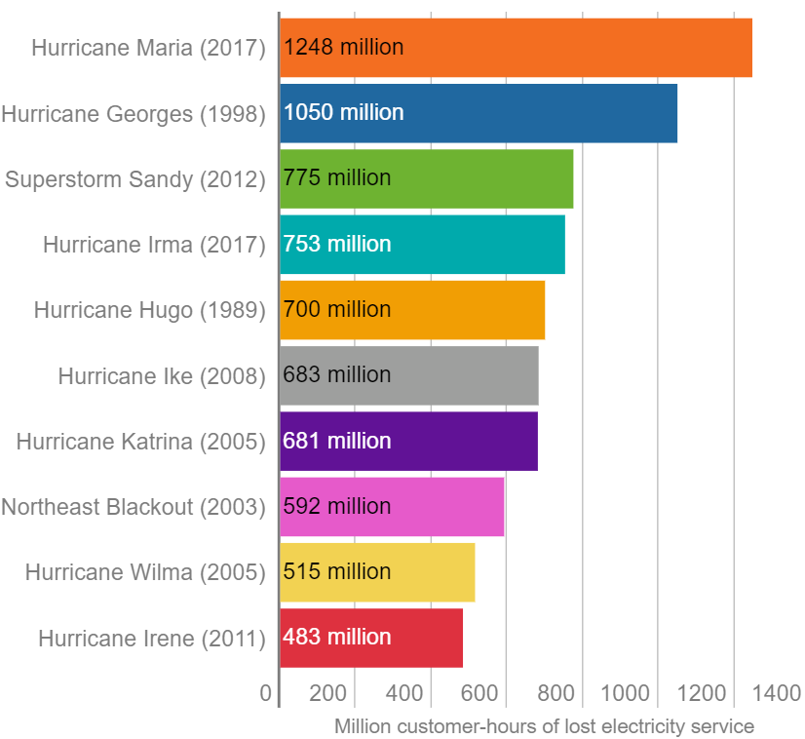
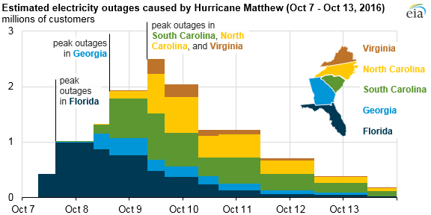
Extreme Weather and Power Grid
Extreme weather events constantly threaten and damage electric power systems.
Overhead distribution systems are vulnerable to severe weather events such as hurricanes, wind storms, heavy rain, lightning, ice, freezing rain, and snow.
Recent years have seen an increase of weather events and outages.
ECpE Department

Slide 7
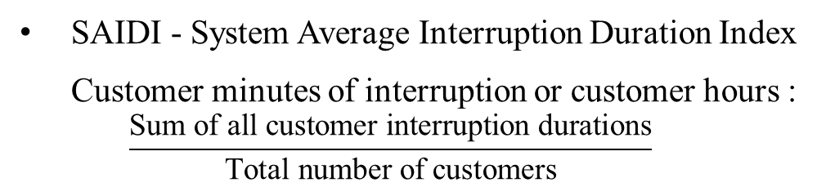
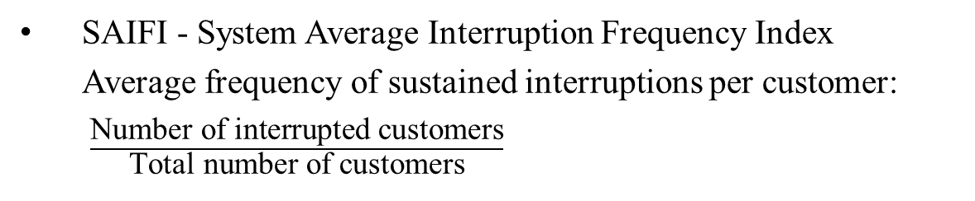
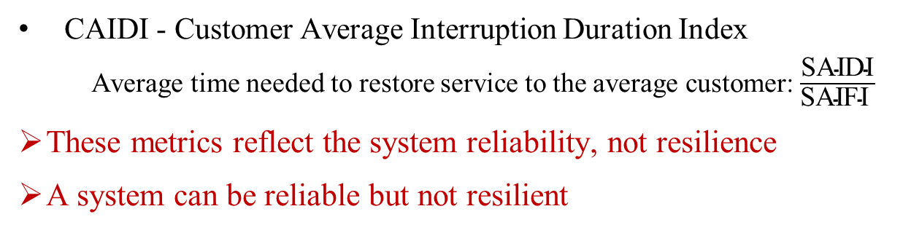
Reliability Metrics
SAIFI - System Average Interruption Frequency Index
  Average frequency of sustained interruptions per customer:
  $\frac{\text{Number} \text{of} \text{interrupted} \text{customers}}{\text{Total} \text{number} \text{of} \text{customers}}$
SAIDI - System Average Interruption Duration Index
Customer minutes of interruption or customer hours :
  $$\frac{\text{Sum} \text{of} \text{all} \text{customer} \text{interruption} \text{durations}}{\text{Total} \text{number} \text{of} \text{customers}}$$
CAIDI - Customer Average Interruption Duration Index
  Average time needed to restore service to the average customer: $\frac{\text{SAIDI}}{\text{SAIFI} }$
These metrics reflect the system reliability, not resilience
A system can be reliable but not resilient
ECpE Department

Slide 8
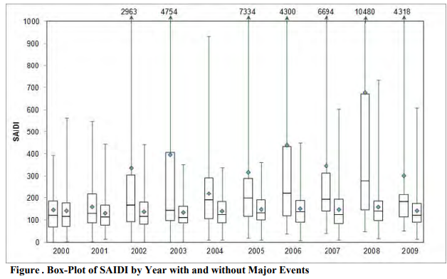
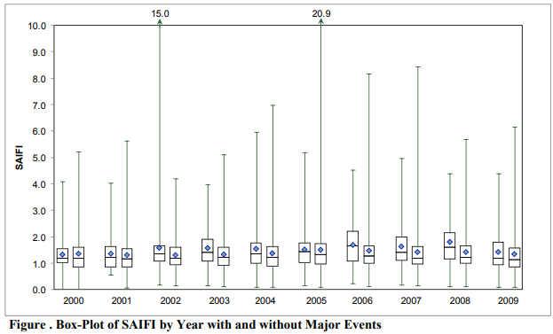
Reliability Metrics (Cont.)
Why reliability metrics cannot be directly applied to resilience?
  Undervalue the impact of large-scale events and focus on normal operating conditions;
  High standard deviation.
Many utilities exclude major events from SAIFI and SAIDI.
There is a need to design new metrics for resilience.
SAIFI with extreme events
SAIFI without extreme events
ECpE Department

Slide 9
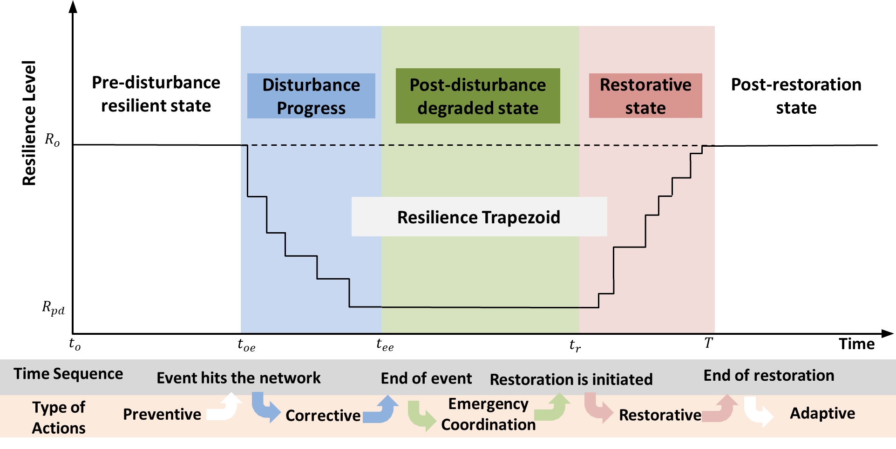
Resilience Curve
(Panteli 2017)
ECpE Department

Slide 10
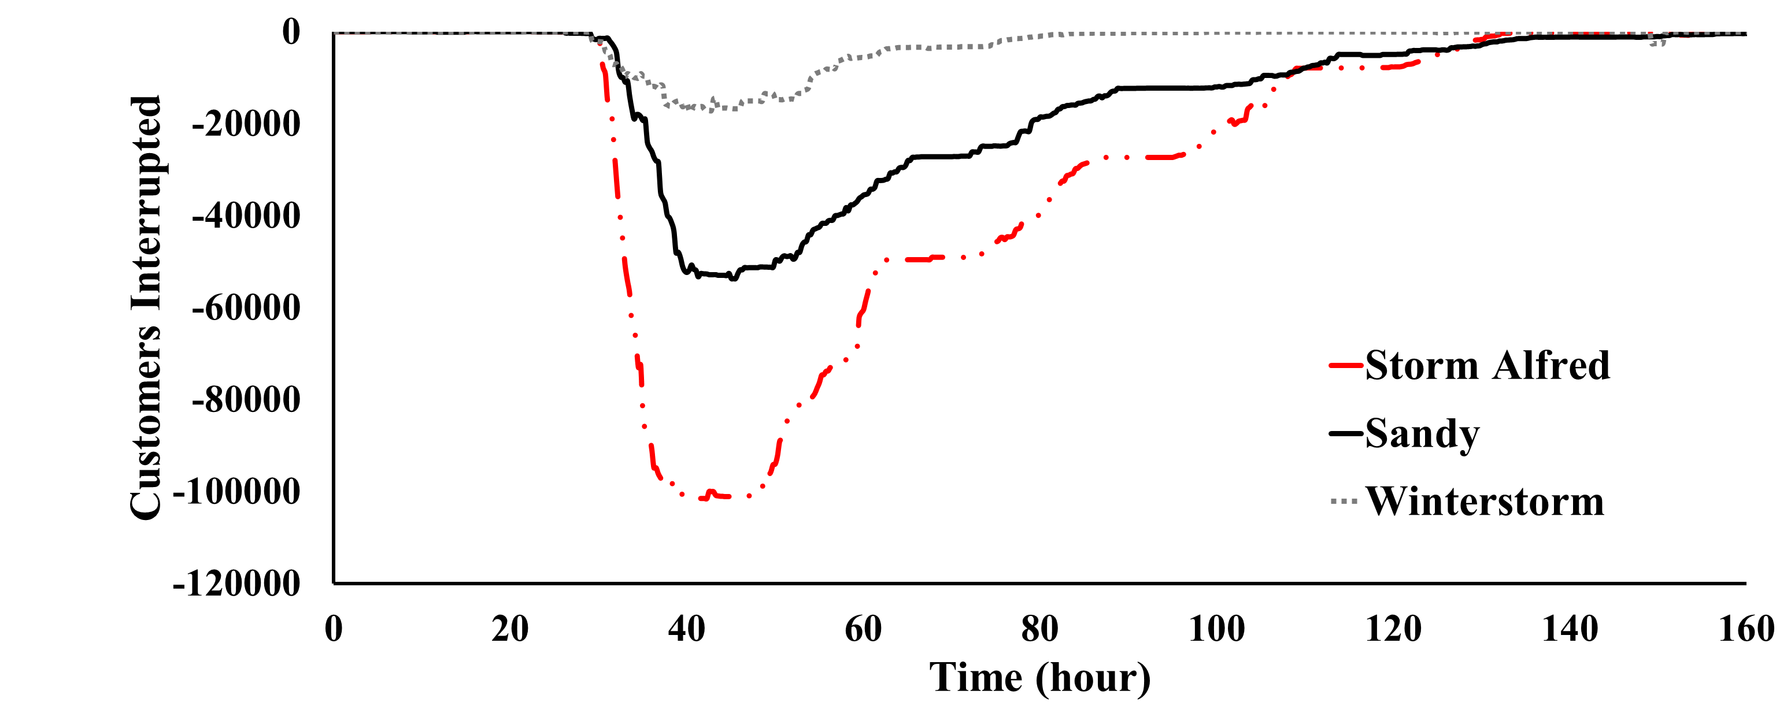
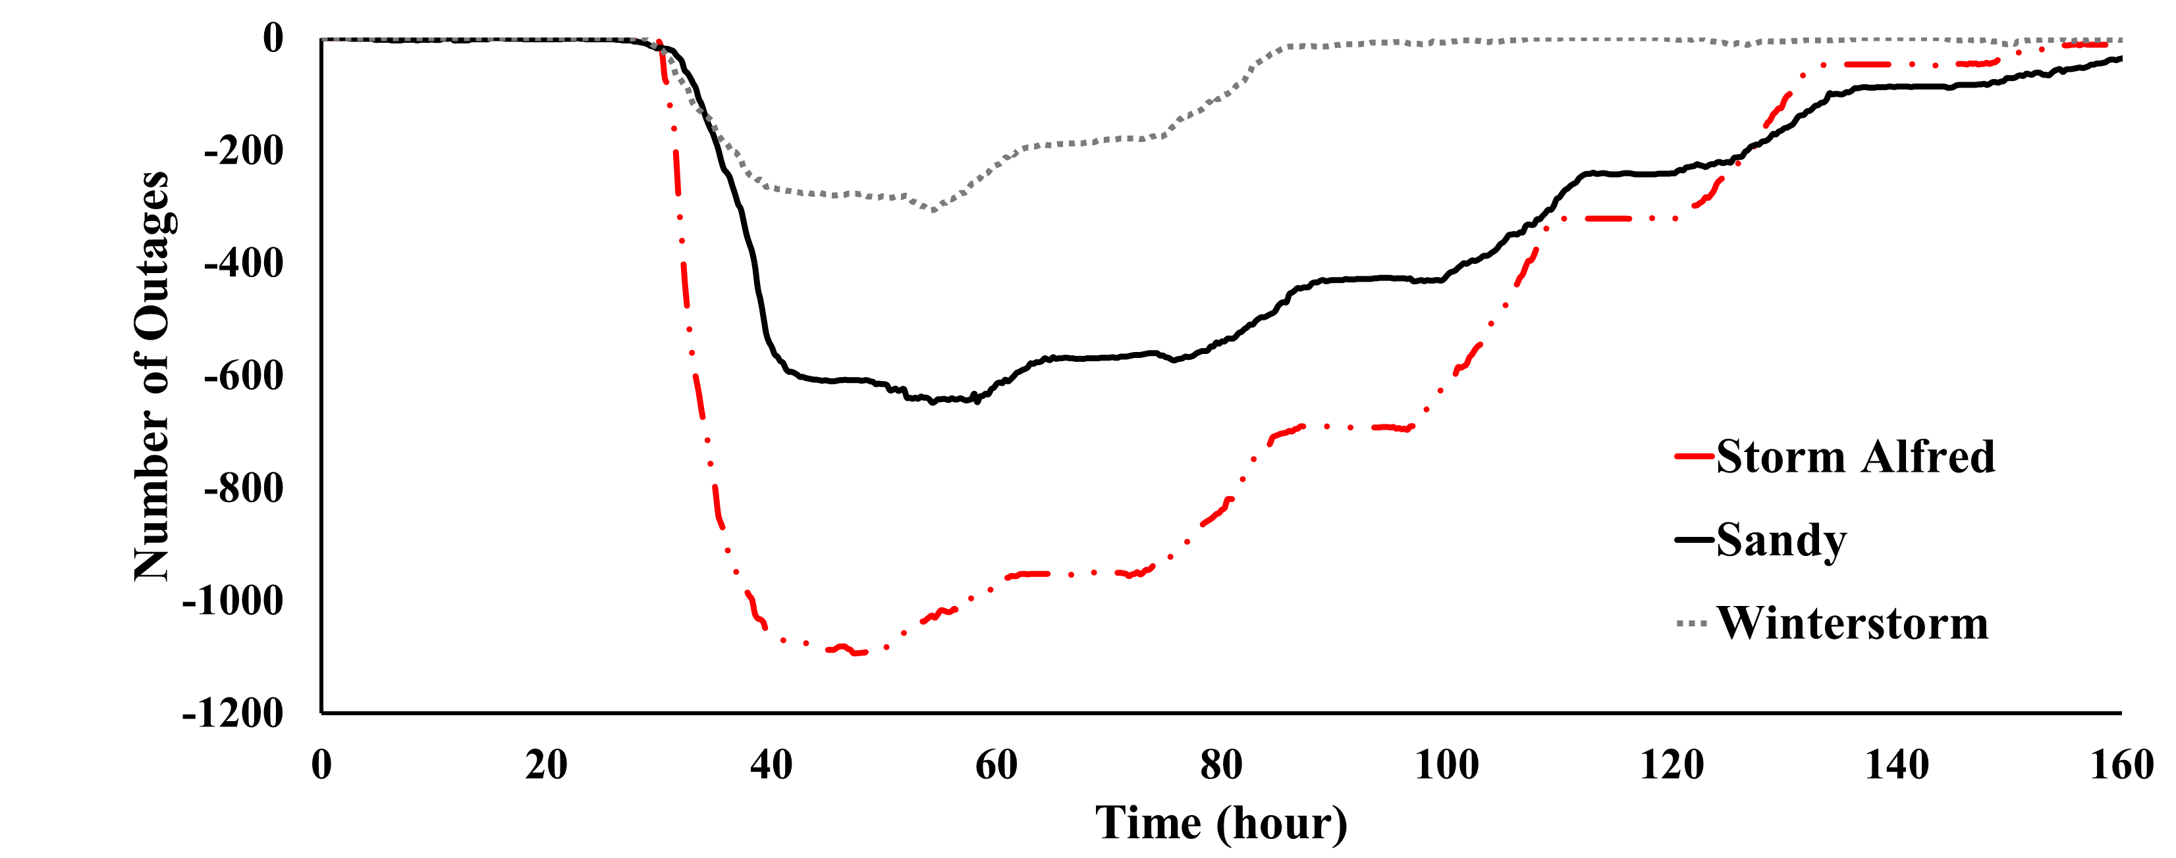
Resilience Curves-Real Data
The figures show the number of interrupted customers and outages for three different events
  Storm Alfred (October 2011)
  Hurricane Sandy (October 2012)
  Winter storm (November 2014)
Storm Alfred occurred two months after Hurricane Irene
ECpE Department

Slide 11
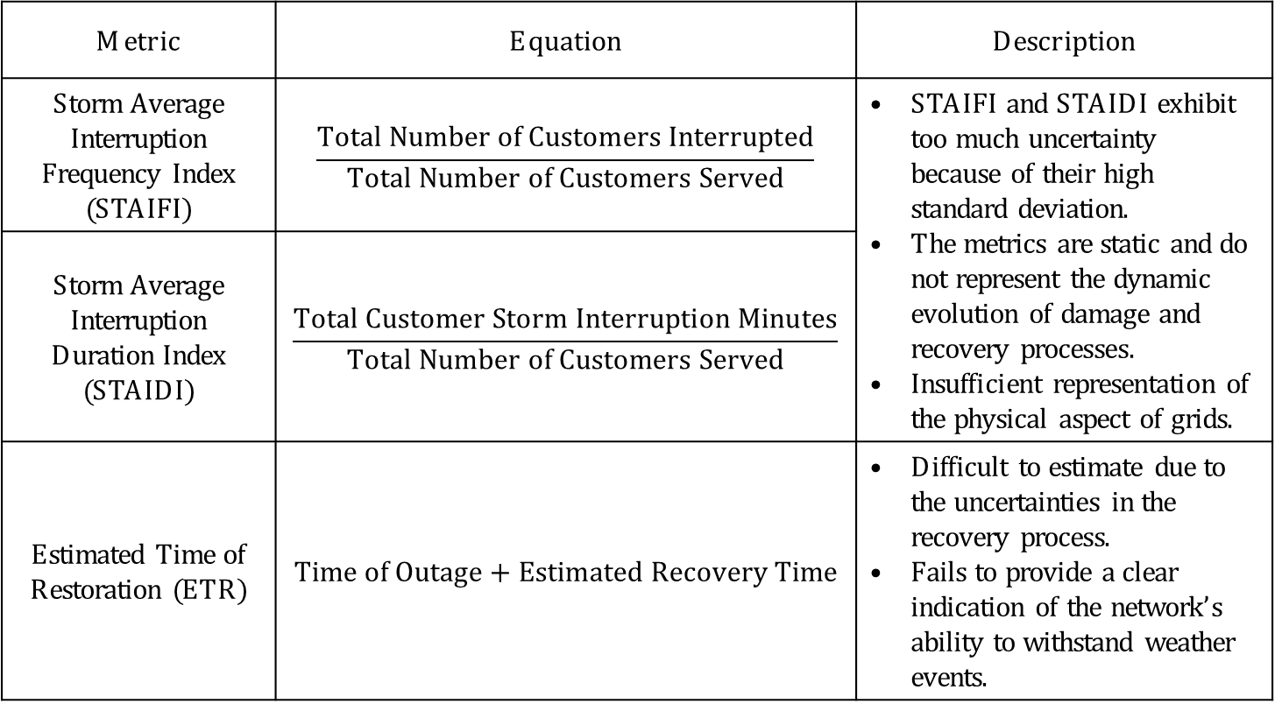
Resilience Metrics (1/3)
Metric | Equation | Description
Storm Average Interruption Frequency Index (STAIFI) | $$\frac{Total Number of Customers Interrupted}{Total Number of Customers Served}$$ | STAIFI and STAIDI exhibit too much uncertainty because of their high standard deviation. The metrics are static and do not represent the dynamic evolution of damage and recovery processes. Insufficient representation of the physical aspect of grids.
Storm Average Interruption Duration Index (STAIDI) | $$\frac{Total Customer Storm Interruption Minutes}{Total Number of Customers Served}$$
Estimated Time of Restoration (ETR) | $$Time of Outage+Estimated Recovery Time$$ | Difficult to estimate due to the uncertainties in the recovery process. Fails to provide a clear indication of the network’s ability to withstand weather events.
ECpE Department

Slide 12
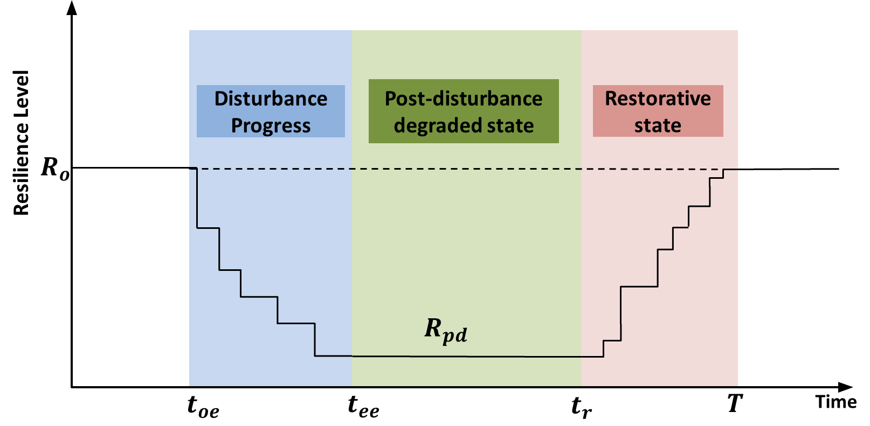
Resilience Metrics (2/3)
Metric | Equation | Description
Speed of degradation | $$\frac{R_{pd}−R_{0}}{t_{ee}−t_{oe}}$$ | This metric indicates how fast the resilience drops after an extreme event. It can be used to measure the network’s ability to withstand the event, but not for recovery.
Amount of degradation | $$R_{0}−R_{pd}$$ | The metric measures the initial impact of the extreme event.
Duration of the post-disturbance degraded state | $$t_{r}−t_{ee}$$ | Indicates the quality of the initial immediate response after the event. This metric highly depends on the fault location, isolation and service restoration (FLISR) technologies being used.
Speed of network recovery | $$\frac{R_{0}−R_{pd}}{T−t_{r}}$$ | The metric measures the quality of the response from the utility. It includes the speed of damage assessment, repair process and crew management, and power restoration operation.
Area of the resilience trapezoid | $$\int_{t_{oe}}^{T}{R(t)}dt$$ | This metric gives an overall indicator of the system performance.
ECpE Department

Slide 13
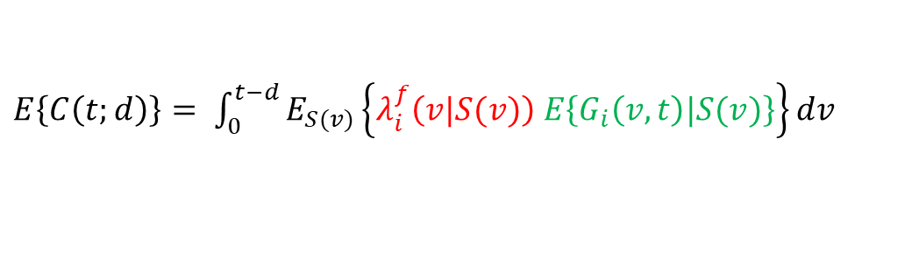


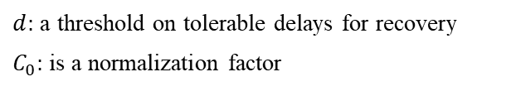
Resilience Metrics (3/3)
Measure resilience at the network-level involving both infrastructure and services (Wei 2013)
Combine the infrastructure and service resilience metrics (Ji 2017)
$$R\left(t\right)=1−\frac{1}{C_{0}}E\left\{C\left(t;d\right)\right\}$$
$d:$ a threshold on tolerable delays for recovery
$C_{0}:$is a normalization factor
Where:
$E\left\{C\left(t;d\right)\right\}= \int_{0}^{t−d}{E_{S(v)}\left\{λ_{i}^{f}\left(v|S(v)\right) E\left\{G_{i}\left(v,t\right)|S(v)\right\}\right\}dv}$
Expected state of the system $S(v)$
Expected disruption cost
Failure rate of the infrastructure
This metric does not include weather variables. An open issue is how to derive resilience metrics combining weather with the infrastructure and services.
ECpE Department

Slide 14
Resilience Enhancement
Phases | Actions
Long-term planning | Infrastructure hardening Vegetation management Adding distributed energy resources (DER) Implementing smart grid technologies Automated switching devices and sensors Smart meters for situational awareness
Short-term pre-event preparation | Weather forecast and damage prediction Pre-position crews Pre-allocate equipment and fuels Pre-position mobile energy sources
Post-event restoration | Automatic fault isolation and service restoration Improved damaged assessment Damage location prediction Smart meters Drones Optimizing repair scheduling and crew routing Dynamic network reconfiguration Use of DERs, demand response, and microgrids for restoration
ECpE Department

Slide 15
Our Research on Resilience
Co-optimize distribution grid operation and crew repair
A. Arif, Z. Wang, J. Wang, C. Chen, “Repair and resource scheduling in unbalanced distribution systems using neighborhood search,” IEEE Trans. Smart Grid, accepted, 2019.
A. Arif, S. Ma, Z. Wang, J. Wang, S. M. Ryan, C. Chen, “Optimizing service restoration in distribution systems with uncertain repair time and demand,” IEEE Trans. Power Syst., vol. 33, no. 6, pp. 6828-6838, Nov. 2018.
A. Arif, Z. Wang, J. Wang, C. Chen, “Power distribution system outage management with co-optimization of repairs, reconfiguration, and DG dispatch,” IEEE Trans. Smart Grid, vol. 9, no. 5, pp. 4109-4118, Sept. 2018.
Resilience: The ability to prepare for and adapt to changing conditions and withstand and recover rapidly from disruptions.
A tri-stage robust optimization model
A two-stage stochastic optimization model
S. Ma, S. Li, Z. Wang, F. Qiu, Resilience-Oriented Distribution System Design with Decision-Dependent Uncertainty, IEEE Trans. Power Syst., 2018.
S. Ma, L. Su, Z. Wang, F. Qiu, Resilience Enhancement of Distribution Grids Against Extreme Weather Events," IEEE Trans. Power Syst., 2018.
S. Ma, B. Chen, Z. Wang, Resilience enhancement strategy for distribution systems under extreme weather events, IEEE Trans. Smart Grid, 2016.
Planning
Preparation
Damage Assessment
Repair & Restoration
Tree trimming
DERs
Automatic Switches
Hardening
Microgrids
Weather forecasting
Outage modelling and prediction
Crew and equipment allocation
Fault location
UAVs
Repair time prediction
Fault isolation and service restoration
Dispatch repair crews and repair scheduling
Microgrid formation
A. Arif, Z. Wang, C. Chen, B. Chen, A stochastic multi-commodity logistic model for disaster preparation in distribution systems, IEEE Trans. Smart Grid, accepted, 2019.
A. Arif, Z. Wang, “Distribution network outage data analysis and repair time prediction using deep learning,” IEEE Int Conf. Probabilistic Methods Appl. Power Syst., Boise, ID, 2018.
ECpE Department

Slide 16
Motivation
Irene
Sandy
Irma
Severe power outages caused by extreme weather events
  Hurricane Irene (2011): 6.69 million customers
  Hurricane Sandy (2012): : 8.66 million customers
  Hurricane Irma (2017): 15 million customers
  Cost of weather-related outages: $25 to $70 billion annually in U.S.
The energy infrastructure is aging, inefficient, and highly vulnerable to extreme weather
We need a resilient system that can withstand the extreme events and recover quickly after the event
ECpE Department

Slide 17
Part I Pre-event Preparation
ECpE Department

Slide 18
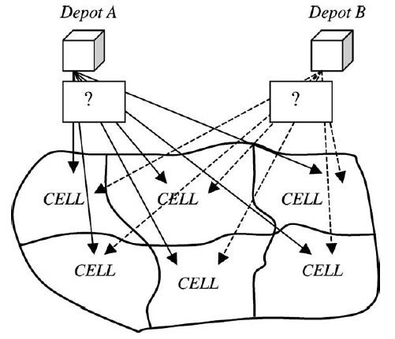
Review – Disaster Preparation
Few studies focused on disaster preparation in the context of power system and its infrastructure
The previous work approached the preparation stage by dividing the electric network into different areas, with each area having a specific demand
(Wang 2004)
Ref. | Application | Method
Wang 2004 | Find optimal number of depots and their locations around the power network | MILP
Coffrin 2011 | Determine the number of resources to stockpile before a disaster in order to repair the power network | SMIP
Khomami 2018 | Preposition repair crews before a disaster near expected damaged components | Heuristic
ECpE Department

Slide 19
Review – Distribution System Restoration
Reconfiguration: optimal reconfiguration of the distribution network with the objective of maximizing the served loads
Reconfiguration and DG dispatch: optimal reconfiguration of the distribution network and DG operation
Microgrids: optimal operation of microgrids for service restoration
Repair Scheduling: repair scheduling of distribution systems’ assets without considering network operations
Method | Model/Algorithm
 | MILP | Stochastic/Robust | Agent-based | Heuristic
Reconfiguration | Butler 2018 | Lee 2015 | Solanki 2007 | Kumar 2008
Reconfiguration+DGs | López 2018 | Chen 2016 | Zidan 2012 | Drayer 2018
Microgrids | Wang 2016 | Wang 2015 | Zhao 2018 | Hu 2017
Repair Scheduling | Golla 2017 | Xu 2007 |  | Johns 1994
MILP: Mixed integer linear Program
ECpE Department

Slide 20
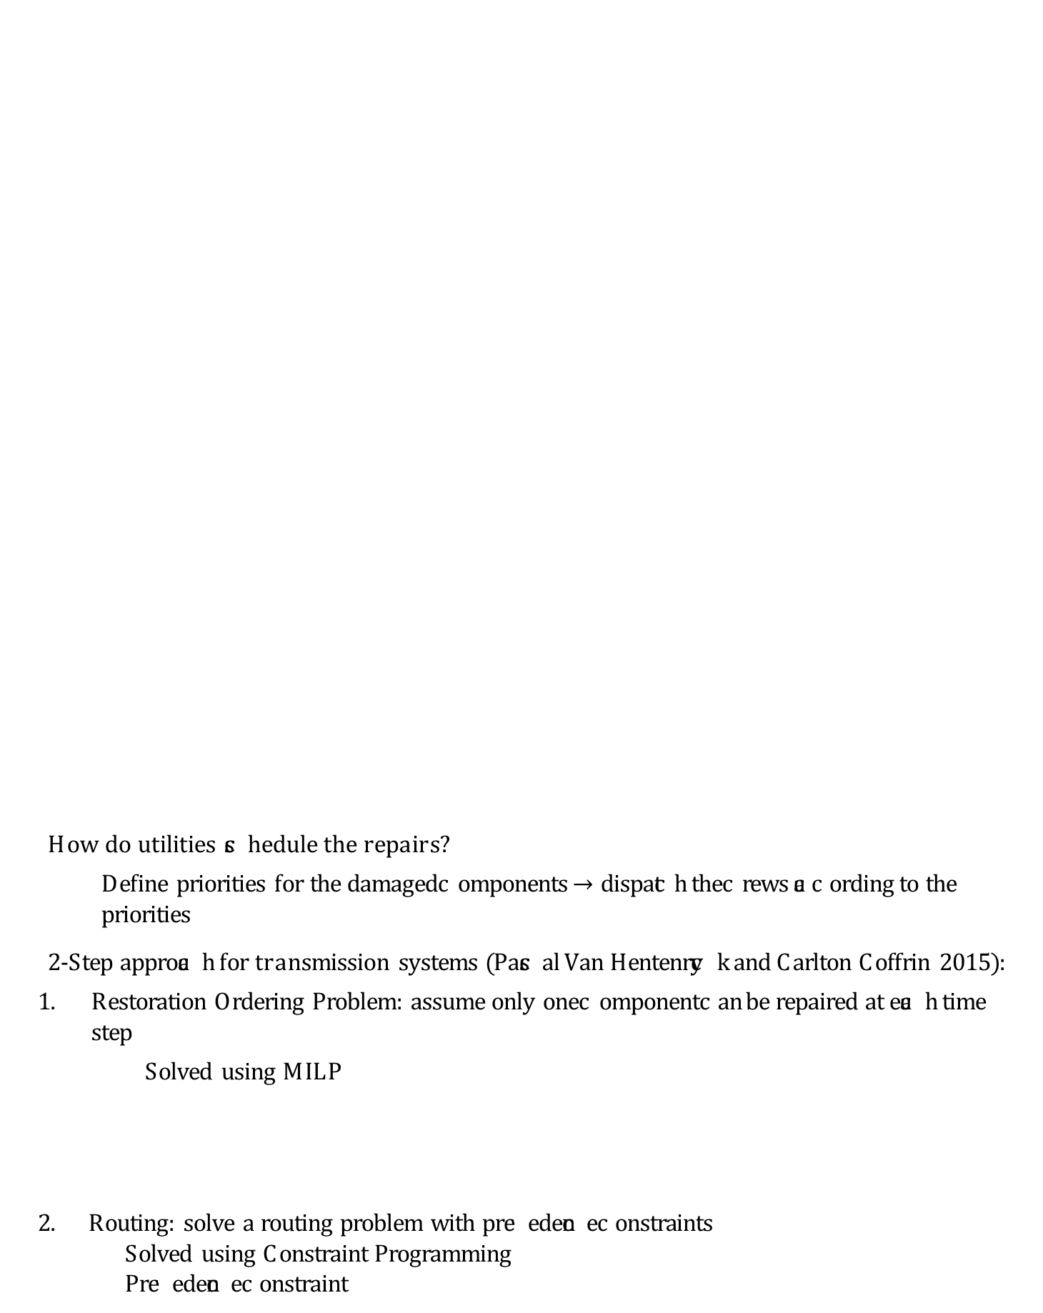
Review: Repair and Restoration
How do utilities schedule the repairs?
  Define priorities for the damaged components $→$ dispatch the crews according to the priorities
2-Step approach for transmission systems (Pascal Van Hentenryck and Carlton Coffrin 2015):
  Restoration Ordering Problem: assume only one component can be repaired at each time step
    Solved using MILP
  2. Routing: solve a routing problem with precedence constraints
    Solved using Constraint Programming
    Precedence constraint
Time step
Repair N1
Repair N2
Repair N5
Repair N4
Repair N10
Start
Repair N1
Repair N2
Repair N5
Repair N4
Repair N10
ECpE Department

Slide 21
Problem Statement
What is missing?
  An optimization strategy for disaster preparation that selects staging areas and allocates crews and equipment while considering the system’s components
  A co-optimization method that jointly optimizes crew routing and distribution system operation
  Solution algorithms for solving these difficult problems
Pre-event preparation
  Choose staging locations
  Mobilize available crews and request assistance if necessary
  Obtain and allocate equipment
Post-event repair and restoration
  Coordinate tree and line crews
  Manage equipment
  Isolate damaged components
  Operate the distribution system
ECpE Department

Slide 22
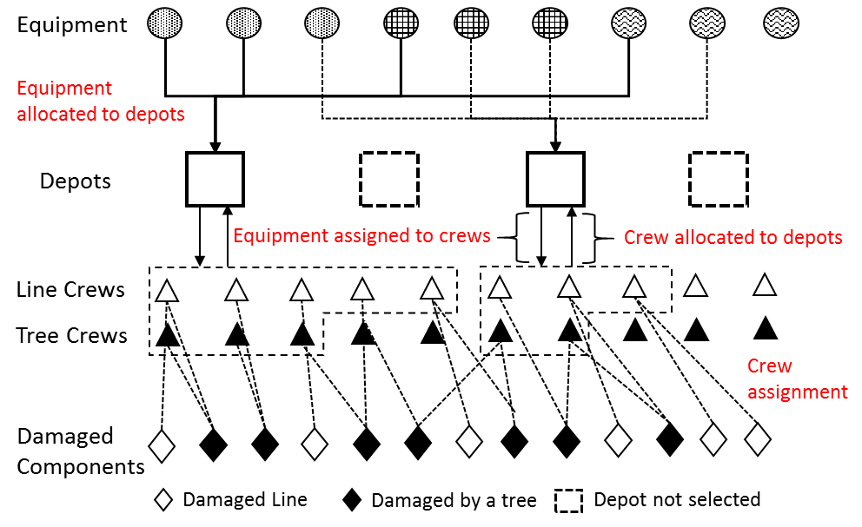
Summary
Develop a two-stage stochastic program
Use fragility models to generate scenarios
Uncertainties: damaged components, equipment, and repair times
Objective:
  Minimize preparation costs and penalty over unmet demand and late repairs
First-stage:
  Depot selection
  Crew and equipment allocation
Second-stage:
  Assign crews to damaged components
ECpE Department

Slide 23
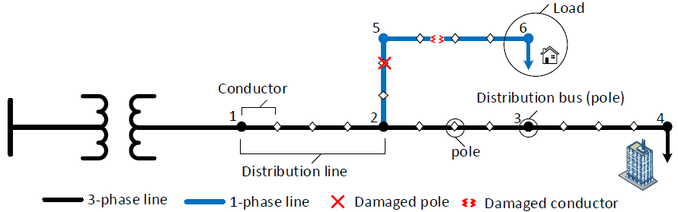

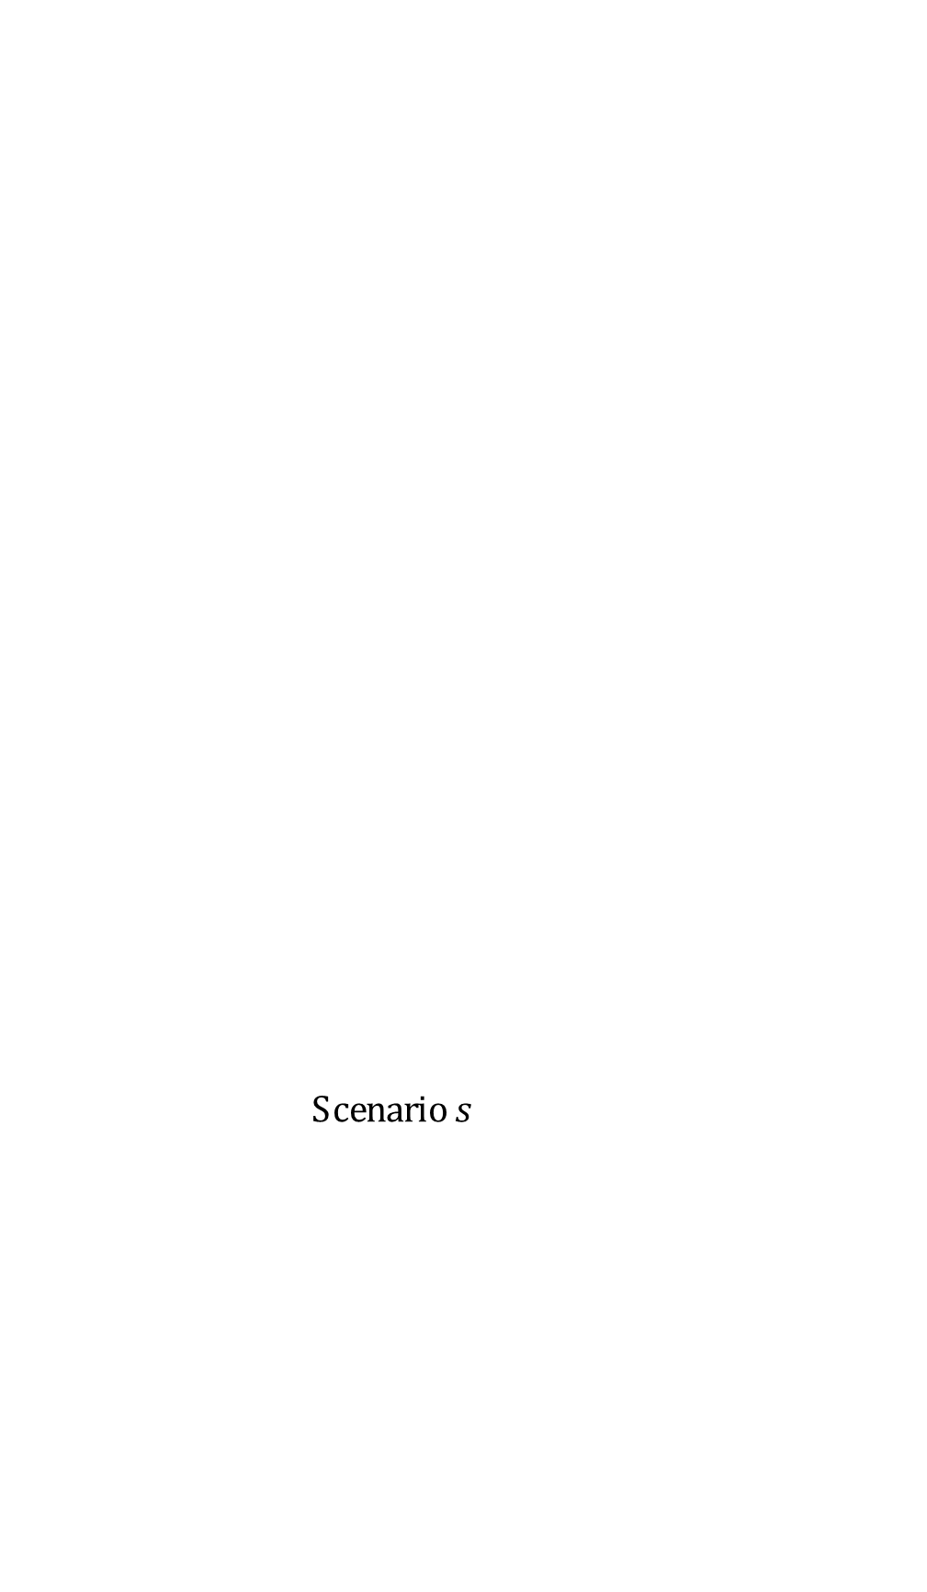
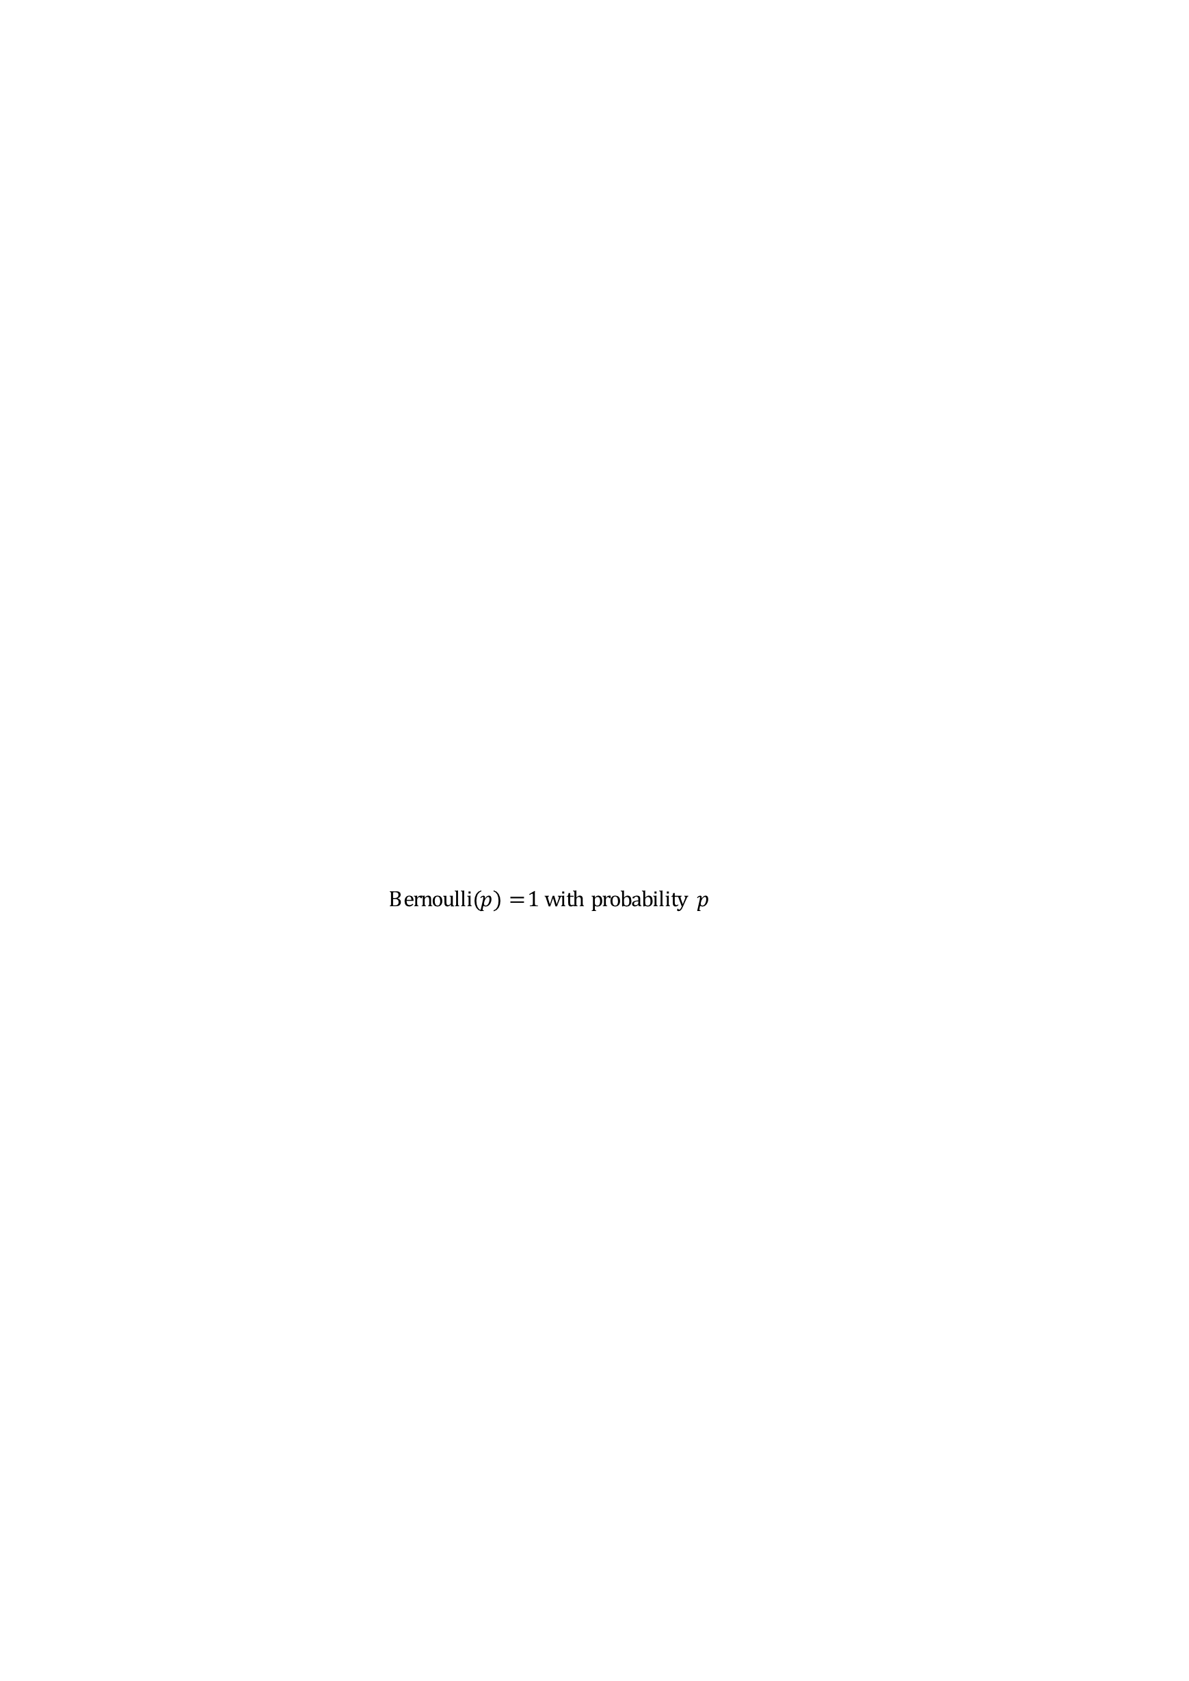
Scenario Generation (1/2)
Assuming a hurricane is forecasted
We generate wind speeds using lognormal distribution and hurricane model (Javanbakht 2018, Kaplan 1995)
  Bernoulli($p$) = 1 with probability $p$
Scenario $s$
$$w_{s}$$
Fragility models
Bernoulli
Failure status
Probability of failure
Fragility models to (Ouyang 2014):
  Calculate the probability of failure of each pole
  Calculate probability of failure of each conductor
    Probability of wind induced damage
    Probability of damage due to fallen trees
ECpE Department

Slide 24
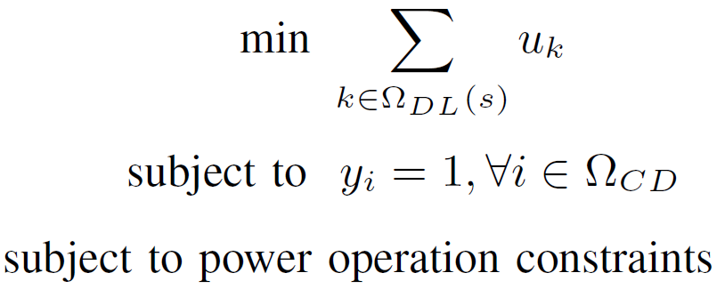
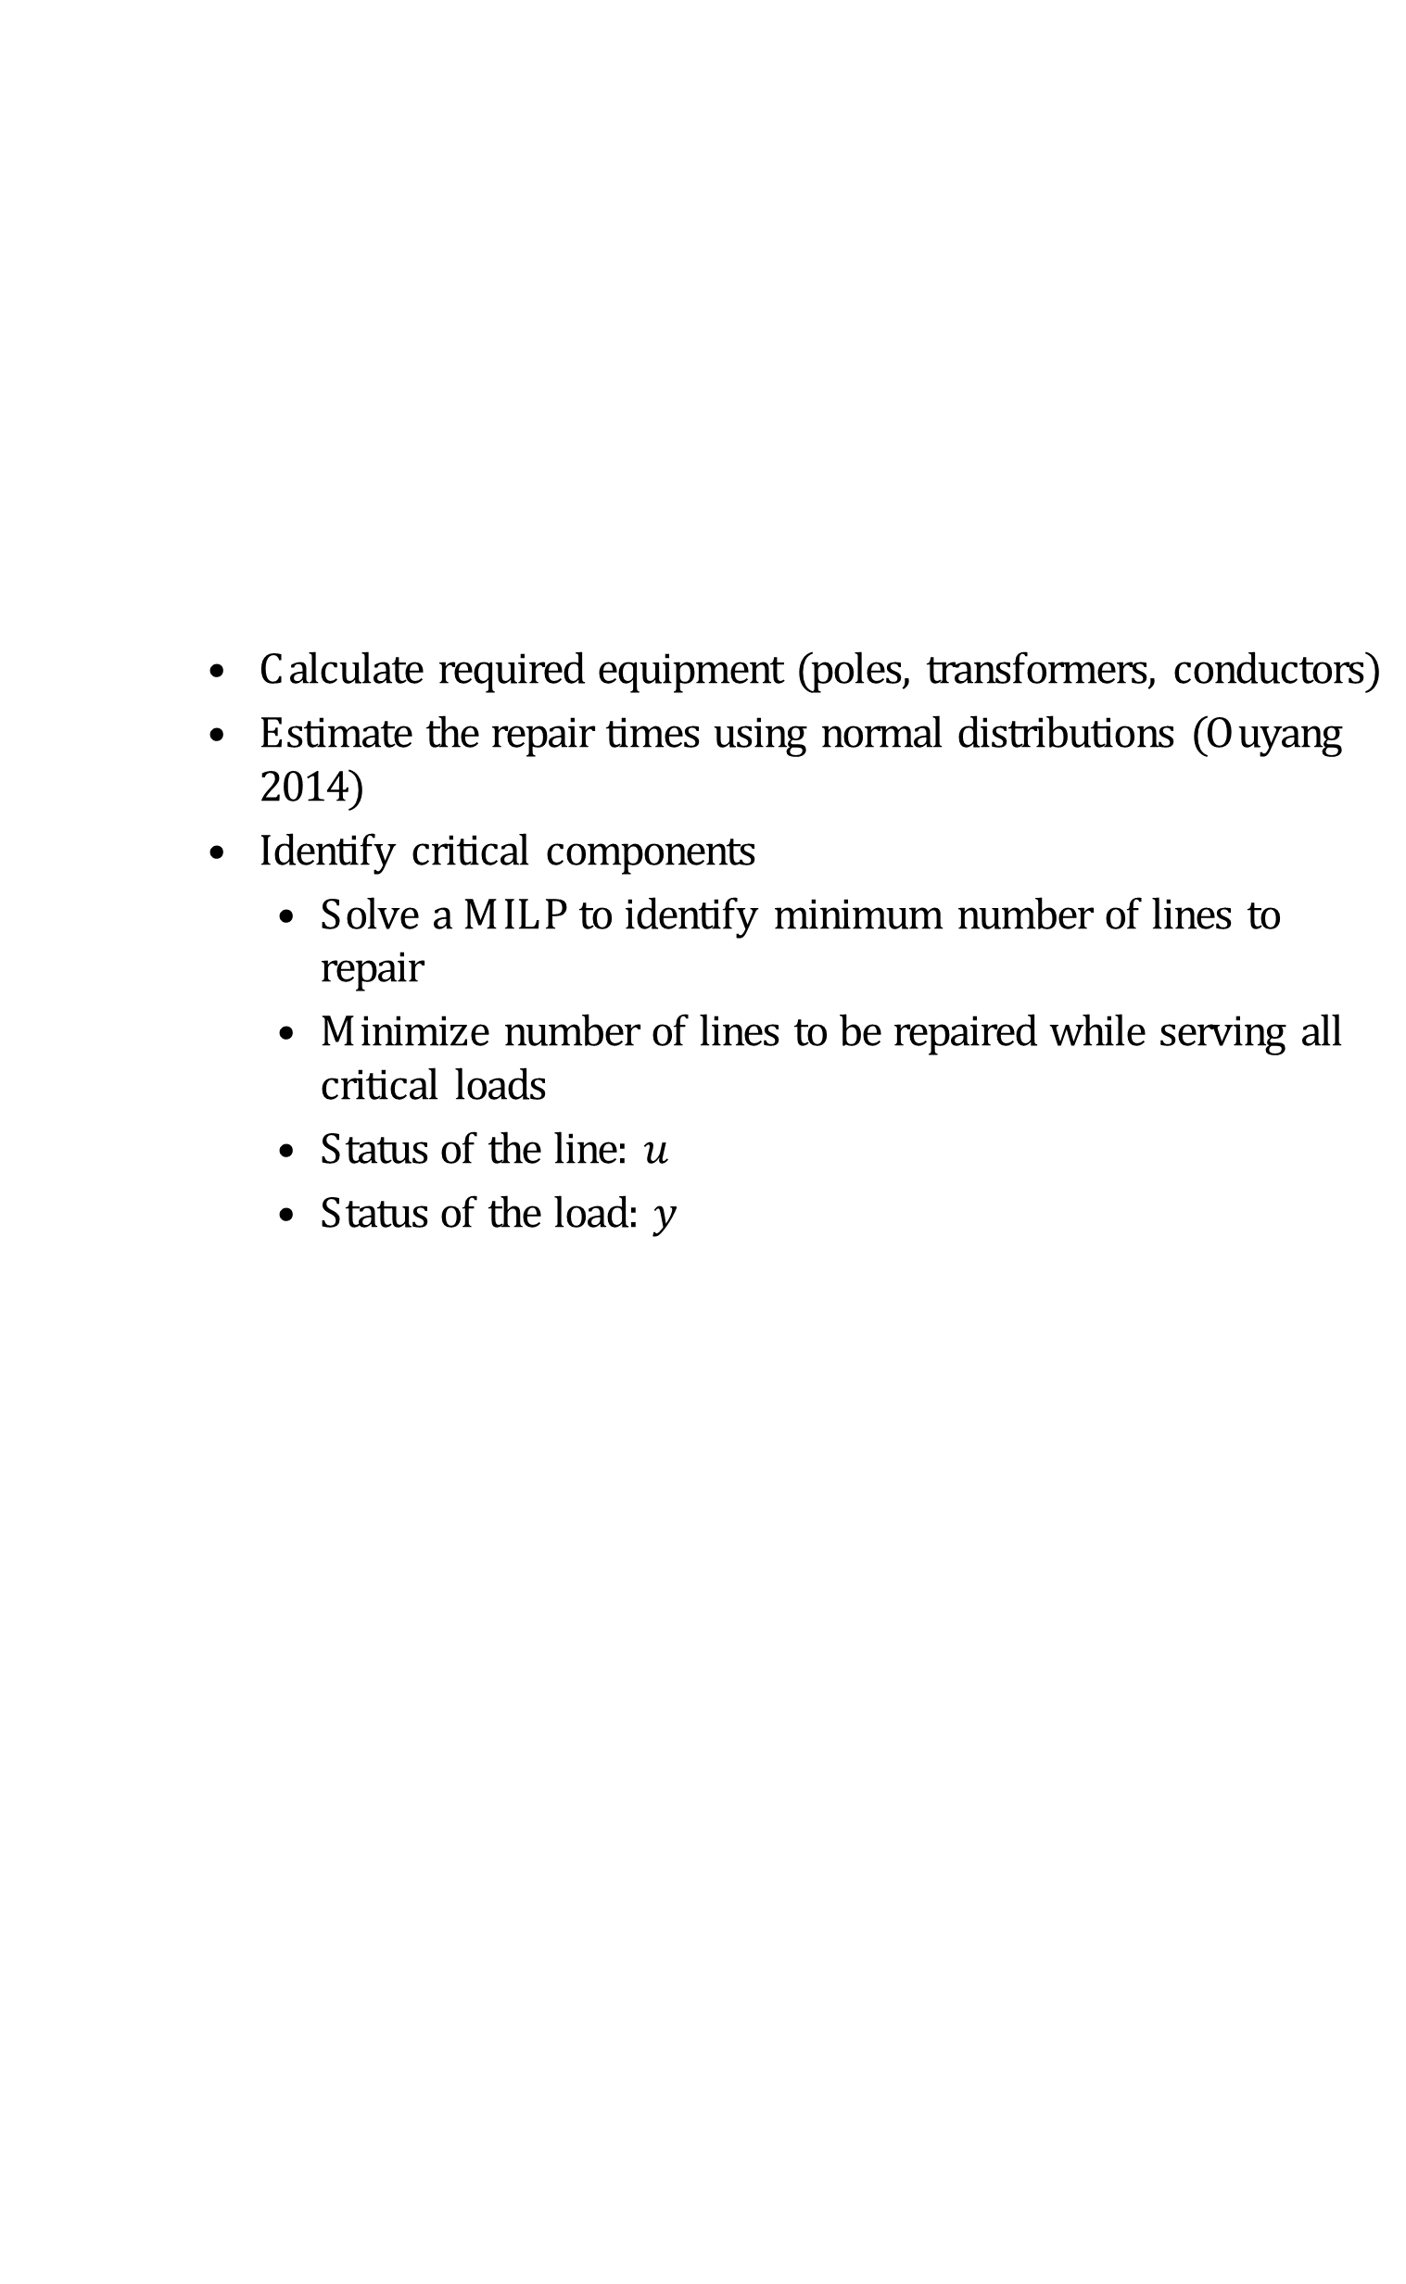
Scenario Generation (2/2)
Calculate required equipment (poles, transformers, conductors)
Estimate the repair times using normal distributions (Ouyang 2014)
Identify critical components
  Solve a MILP to identify minimum number of lines to repair
  Minimize number of lines to be repaired while serving all critical loads
  Status of the line: $u_{k}$
  Status of the load: $y_{i}$
ECpE Department

Slide 25
Objective
First-stage objective: minimize the costs of equipment transportation, ordering equipment and external crews, and staging depots
Second-stage objective:
  Minimize the costs associated with the crews. The costs of crews include labor, food, and accommodation
  Minimize penalty costs of unmet equipment demand and time it takes to repair all components
ECpE Department

Slide 26
Constraints
First-stage constraints
  Select depots
  Transfer existing equipment/crews between depots
  Acquire new equipment/crews
  Depot capacity constraint
Second-stage constraints
  Crews are assigned to repair damaged the components
  The assignment is constrained by the distance
  Calculate working hours
  Assign equipment to the crews
  We must have enough equipment for critical components
  Calculate unmet equipment demand
ECpE Department

Slide 27
Solution Methods
The Extensive Form (EF)
  Write down the full variable and constraint set for all scenarios
  Attempt to solve with a commercial MIP solver
  Best solution, but often does not work due to memory or time limits
Progressive hedging
  Scenario-based decomposition
  Pros: parallelizable
  Cons: heuristic
ECpE Department

Slide 28
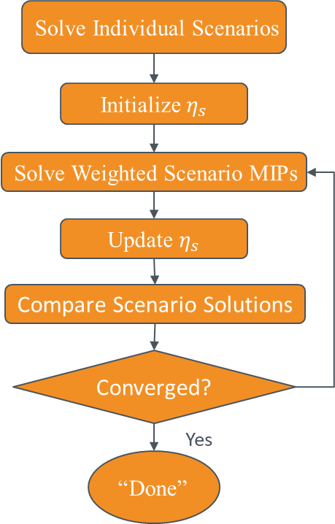
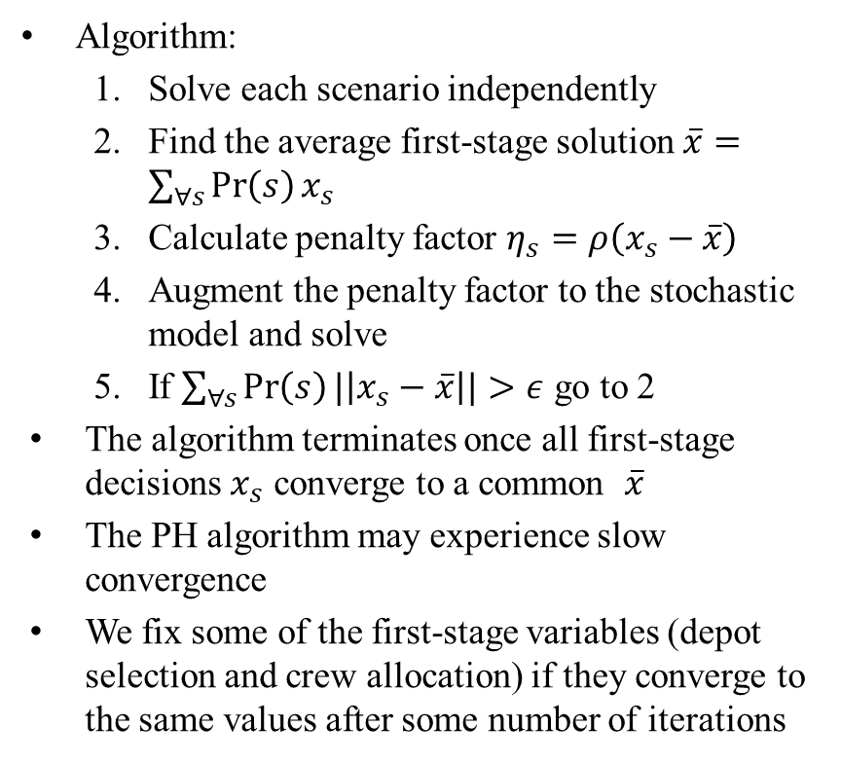
Solution Algorithm - Progressive Hedging
Algorithm:
  Solve each scenario independently
  Find the average first-stage solution $\overline{x}=\sum_{∀s}{\operatorname{Pr}\left(s\right)x_{s}}$
  Calculate penalty factor $η_{s}=ρ\left(x_{s}−\overline{x}\right)$
  Augment the penalty factor to the stochastic model and solve
  If $\sum_{∀s}{\operatorname{Pr}\left(s\right)|\left|x_{s}−\overline{x}\right||}>ε$ go to 2
The algorithm terminates once all first-stage decisions $x_{s}$ converge to a common $\overline{x}$
The PH algorithm may experience slow convergence
We fix some of the first-stage variables (depot selection and crew allocation) if they converge to the same values after some number of iterations
ECpE Department

Slide 29
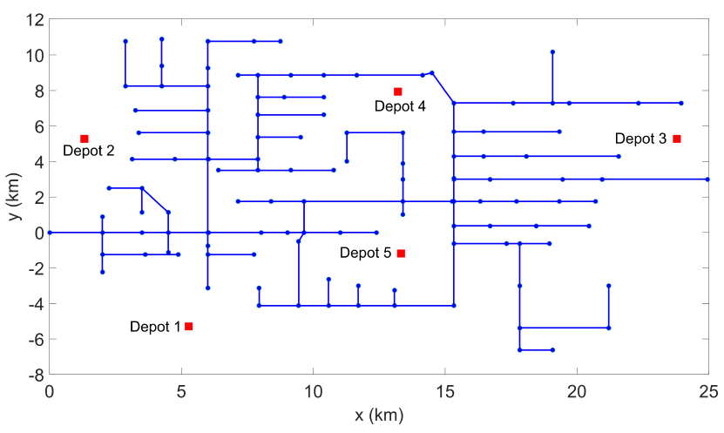
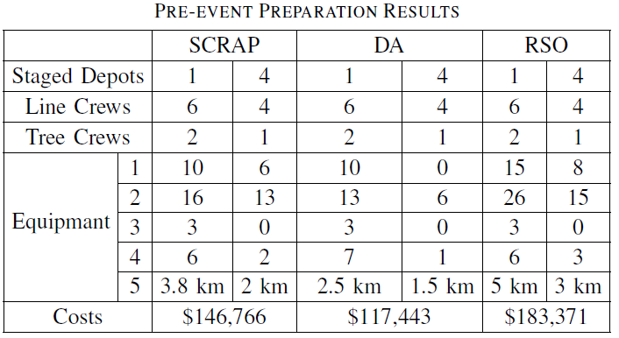
Results (1/2)
IEEE 123-bus system
Proposed method (SCRAP) is compared with:
  Deterministic allocation (DA)
  Robust stochastic optimization method (RSO) (Bozorgi-Amiri 2013)
Main difference is in the number of equipment acquired
The deterministic solution did not consider some of the extreme cases
RSO favors a solution that would perform better with worst-case scenarios
ECpE Department

Slide 30
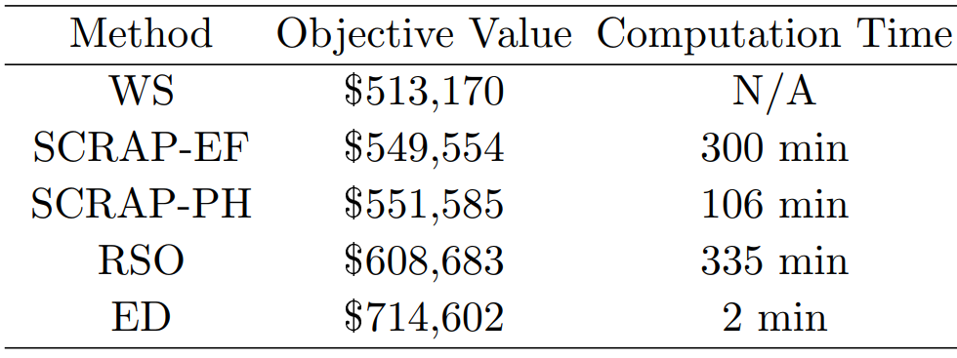
Results (2/2)
The wait-and-see (WS) solution is calculated to provide a lower bound
We calculate the objective value of the stochastic model for each method by using the first-stage decisions of the different methods
ECpE Department

Slide 31
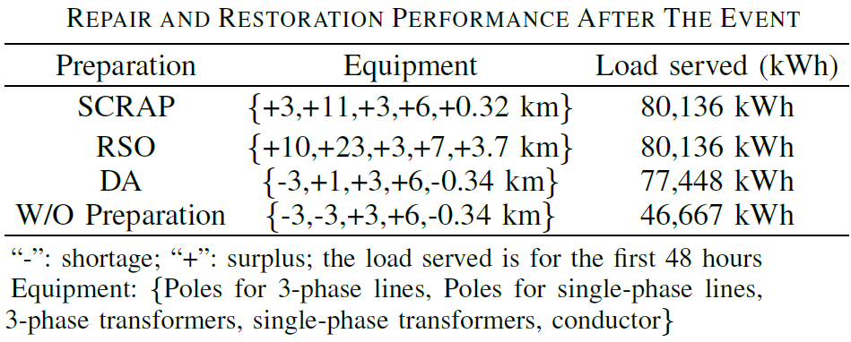
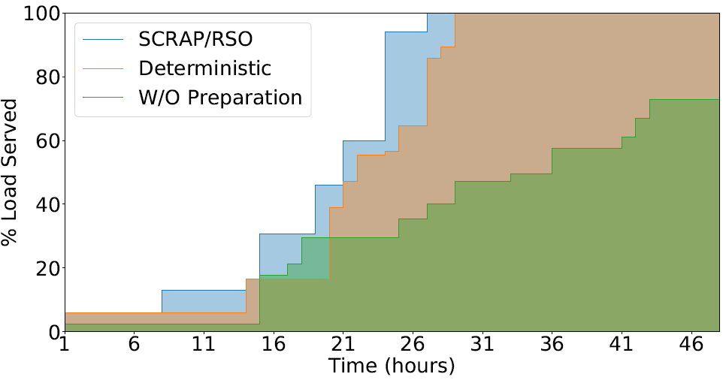
Restoration Phase
To assess the devised preparation plan, we solve the repair and restoration problem with and without preparation
A new random damage scenario is generated on the IEEE 123-bus system
The stochastic and robust models have enough equipment, however, RSO has a large surplus
ECpE Department

Slide 32
Part II Post-event Outage Management and Service Restoration
ECpE Department

Slide 33
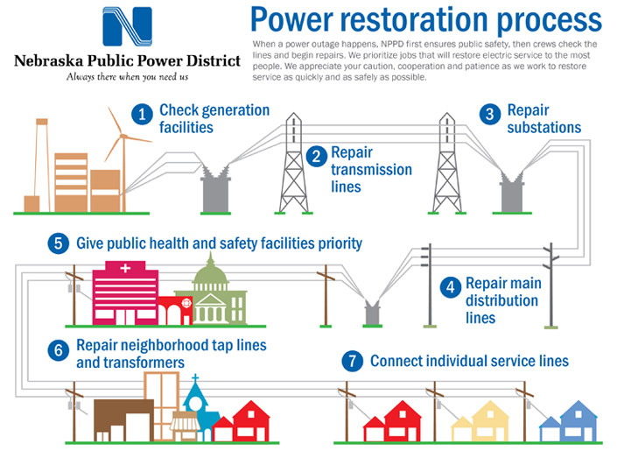
Distribution System Outage Management
Distribution system outage management involves utility procedures and computer-based tools to efficiently and effectively:
  Predict and prepare for outages
  Detect and locate outages
  Dispatch crews and manage equipment
  Restore the distribution system
    isolate faults and restore the healthy sections by reconfiguring the network
  Provide feedback to affected customers
Source: https://www.nppd.com/outages/restoring-power/
ECpE Department

Slide 34
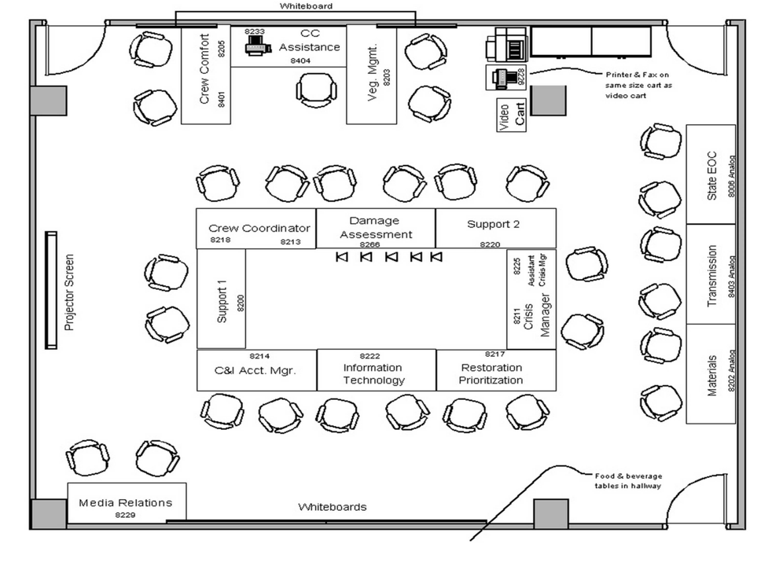
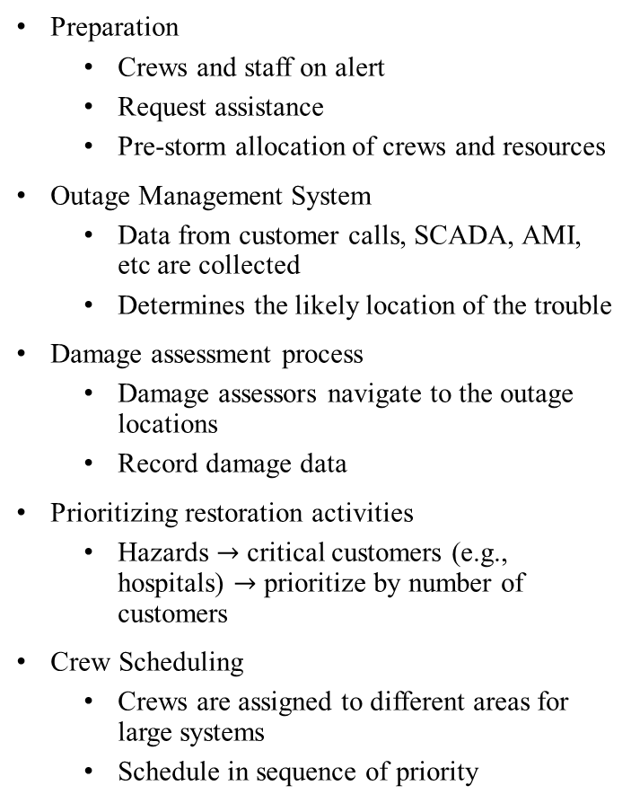
Utility Practices (1/3)
Preparation
  Crews and staff on alert
  Request assistance
  Pre-storm allocation of crews and resources
Outage Management System
  Data from customer calls, SCADA, AMI, etc are collected
  Determines the likely location of the trouble
Damage assessment process
  Damage assessors navigate to the outage locations
  Record damage data
Prioritizing restoration activities
  Hazards $→$ critical customers (e.g., hospitals) $→$ prioritize by number of customers
Crew Scheduling
  Crews are assigned to different areas for large systems
  Schedule in sequence of priority
Crisis Center – Westar Energy
Source: https://www.westarenergy.com/
ECpE Department

Slide 35
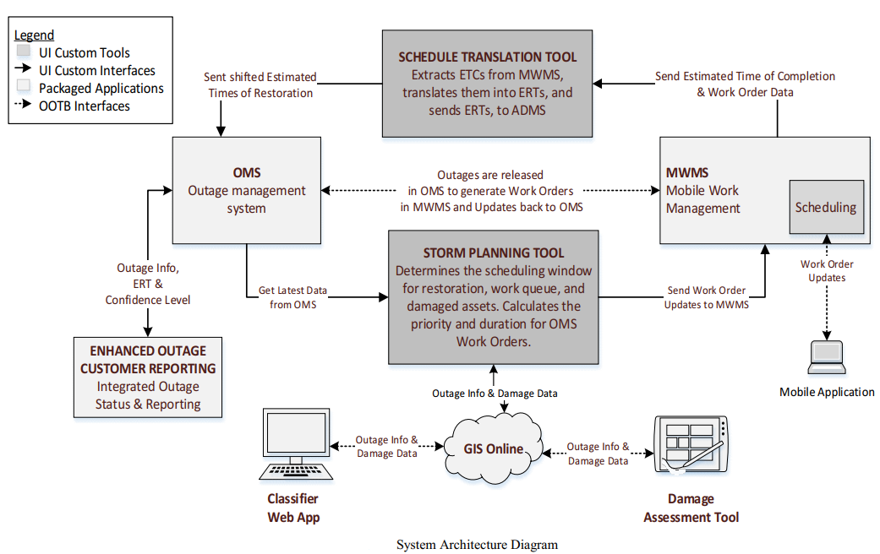

Utility Practices (2/3)
UI: United Illuminating
ETC: Estimated Time of Completion
ERT: Estimated Restoration Times
MWMS: Mobile Work Management System
ECpE Department

Slide 36
Utility Practices (3/3)
Challenges
Distribution systems are becoming more complex with new devices and systems. DGs and automatic switches can greatly decrease the restoration time if operated effectively.
Managing crews, equipment, and the operation of the network is a demanding task. After an extreme event, a sudden influx of crews can overwhelm operators and storm planners.
The recovery operation problem and repair scheduling are interdependent.
Currently, crews are scheduled based on a priority list. If the priorities are not well defined, the schedule will not be efficient.
Improvements
Development of advanced optimization methods to jointly optimize the recovery operation and logistic problems. An optimization process can help the operator in making critical and more informed decisions after outages.
Design solution algorithms for the co-optimization problem to obtain a quick and efficient solution
ECpE Department

Slide 37
Distribution System Restoration
Reconfiguration: optimal reconfiguration of the distribution network with the objective of maximizing the served loads.
Reconfiguration and DG dispatch: optimal reconfiguration of the distribution network and DG operation.
Networked Microgrids: optimal operation of interconnected individual microgrids with defined boundaries.
Microgrid formation: optimal operation of microgrids with dynamic boundaries.
Repair Scheduling: repair scheduling of distribution systems’ assets without considering network operations.
Method | Model/Algorithm
 | MILP | Stochastic/Robust | Agent-based | Heuristic | Other
Reconfiguration | [3]-[5] | [6]-[7] | [8]-[10] | [12]-[14] | [15]-[17]
Reconfiguration+DGs | [18]-[20] | [21]-[24] | [25]-[27] | [28]-[30] | [31]-[32]
Networked Microgrids | [33]-[36] | [37]-[40] | [41]-[42] | [43]-[44] | [45]
Microgrid Formation | [46]-[50] | [51]-[54] | [52]-[55] | [56] | [57]
Repair Scheduling | [58] | [59] |  | [58]-[61] | [62]-[65]
MILP: Mixed integer linear Program
ECpE Department

Slide 38
Review: Repair and Restoration (1/3)
MILP for transmission system repair and restoration (Arab 2015)
Limited by number of crews
Repair time
 | Repair status
Line 1 | 1 | 1 | 1 | 0 | 0 | 0 | 0
Line 2 | 1 | 1 | 1 | 1 | 0 | 0 | 0
Line 3 | 0 | 0 | 0 | 1 | 1 | 0 | 0
Line 4 | 0 | 0 | 0 | 0 | 1 | 1 | 0
Assumptions
Neglect travel time
Crews are immediately present at the damaged components
No specific crew assignments
Model
Transmission system operation
Repair schedule
 | Operation status
Line 1 | 0 | 0 | 0 | 1 | 1 | 1 | 1
Line 2 | 0 | 0 | 0 | 0 | 1 | 1 | 1
Line 3 | 0 | 0 | 0 | 0 | 0 | 1 | 1
Line 4 | 0 | 0 | 0 | 0 | 0 | 0 | 1
ECpE Department

Slide 39
Review: Repair and Restoration (2/3)
A project by Los Alamos National Lab and National ICT Australia (NICTA), Australian National University.
2-Step approach for transmission systems (Pascal Van Hentenryck and Carlton Coffrin 2015):
  Restoration Ordering Problem: assume only one component can be repaired at each time step
    Solved using MILP
  Routing: solve a routing problem with precedence constraints
    Solved using Constraint Programming
    Precedence constraint
Time step
Repair N1
Repair N2
Repair N5
Repair N4
Repair N10
Start
Repair N1
Repair N2
Repair N5
Repair N4
Repair N10
ECpE Department

Slide 40
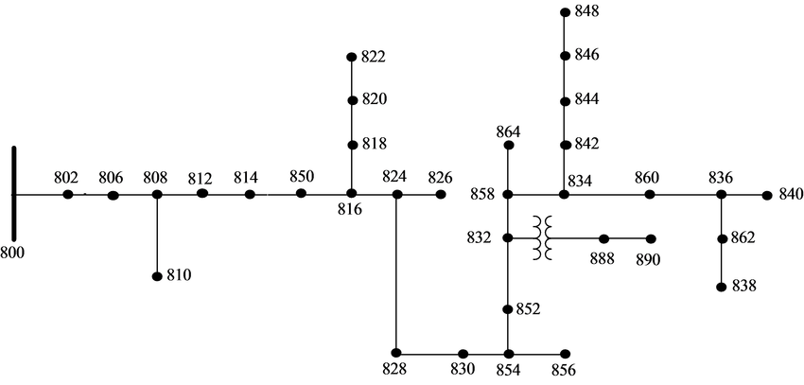
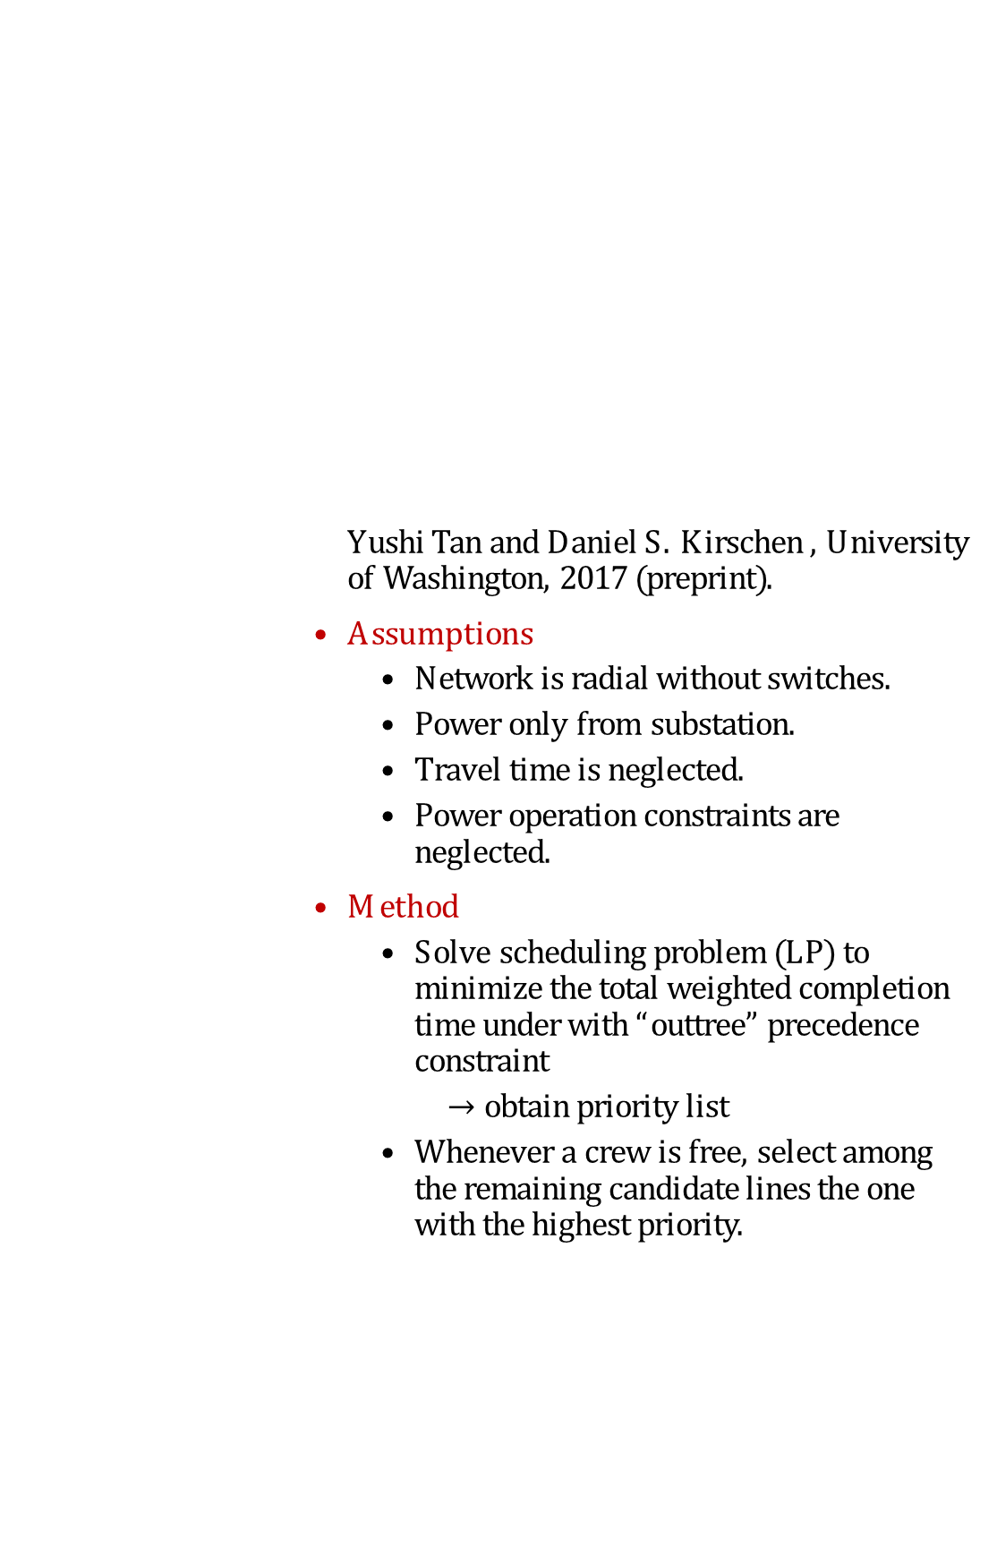
Review: Repair and Restoration (3/3)
Yushi Tan and Daniel S. Kirschen , University of Washington, 2017 (preprint).
Assumptions
  Network is radial without switches.
  Power only from substation.
  Travel time is neglected.
  Power operation constraints are neglected.
Method
  Solve scheduling problem (LP) to minimize the total weighted completion time under with “outtree” precedence constraint
    $→$ obtain priority list
  Whenever a crew is free, select among the remaining candidate lines the one with the highest priority.
ECpE Department

Slide 41
Research Objectives
What is missing?
  A co-optimization method that jointly optimizes crew routing and distribution system operation.
  Modeling fault isolation and tree/obstacle removal before repairing the lines.
  A preparation strategy before repair and restoration to ensure a fast response.
Objectives:
Proactive response: develop a stochastic program to pre-stage and prepare human resources and equipment before extreme weather events.
Develop MILP and stochastic mixed integer linear program (SMIP) models to co-optimize repair scheduling and the recovery operation of distribution systems.
Design solution algorithms for solving the above problems.
Pre-storm planning
Choose staging locations
Mobilize available crews and request assistance if necessary
Obtain and allocate resources and equipment
Post-storm repair and restoration
Coordinate tree and line crews
Manage Equipment
Isolate damaged components
Operate generators and switches
Outage scenario generation
Weather forecast
Fragility model
ECpE Department

Slide 42
Contributions
A novel mathematical model for jointly optimizing the repair crew routing and distribution network operation problems is developed. The model can improve utilities’ response to extreme events. Our research group is the first to develop a single mathematical model for co-optimizing crew routing and power restoration.
A mathematical formulation is developed for fault isolation and service restoration. Isolation has been neglected in distribution system restoration studies that use mathematical programming.
Development of efficient algorithms for solving the co-optimization problem.
  Cluster-based decomposition
  Priority-based decomposition
  Hybrid mathematical programming and search algorithm
4 journal and 6 conference papers have been published, and 1 journal paper is under review.
ECpE Department

Slide 43
Mathematical Modeling
ECpE Department

Slide 44





Problem Overview
A
B
1
3
5
C
2
4
Closed switch
Open switch
ECpE Department

Slide 45
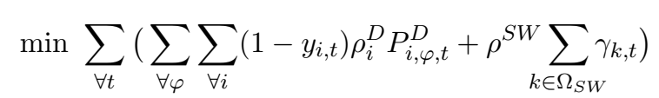
Mathematical Model
Distribution system repair and restoration problem (DSRRP)
Assumption:
Damage assessment has been conducted: the locations are known and the repair time is estimated.
Objective
  Minimize cost of shedding loads and switching operation
Constraints
  Distribution system operations
    Power flow
    Cold-load pickup
    Voltage constraints
    Reconfiguration and fault isolation constraints
  Crew routing
    Path-flow constraints
    Start/end location
    A damaged line is repaired by one crew
    Arrival (repair start) time
    Tree removal before line repair
    Equipment constraints
ECpE Department

Slide 46
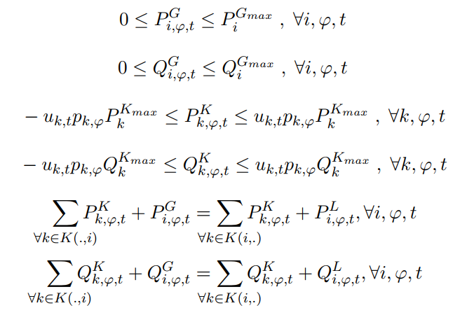
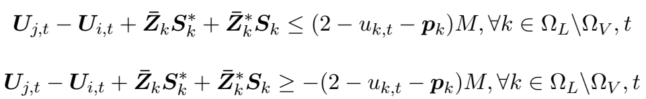
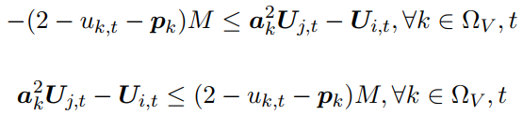
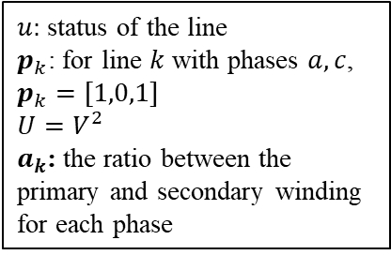
Distribution System
Generator limits
Line limits
Node balance
Kirchhoff voltage law (Chen 2018)
  Losses are neglected
Voltage regulators
1
2
3
4
$u:$ status of the line
$p_{k}$: for line $k$ with phases $a,c$, $p_{k}=[1,0,1]$
$$U=V^{2}$$
$a_{k}$: the ratio between the primary and secondary winding for each phase
5
ECpE Department

Slide 47
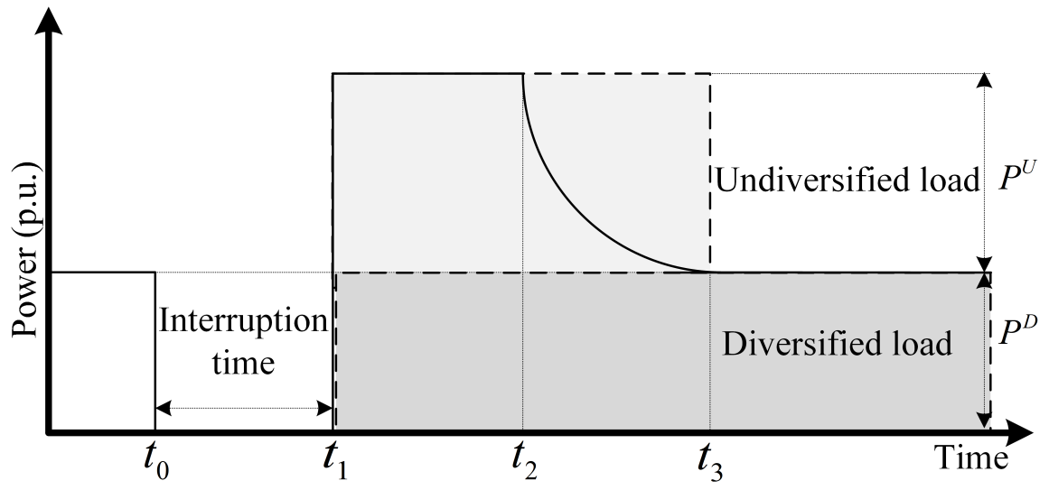
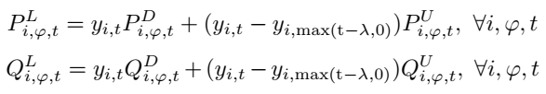
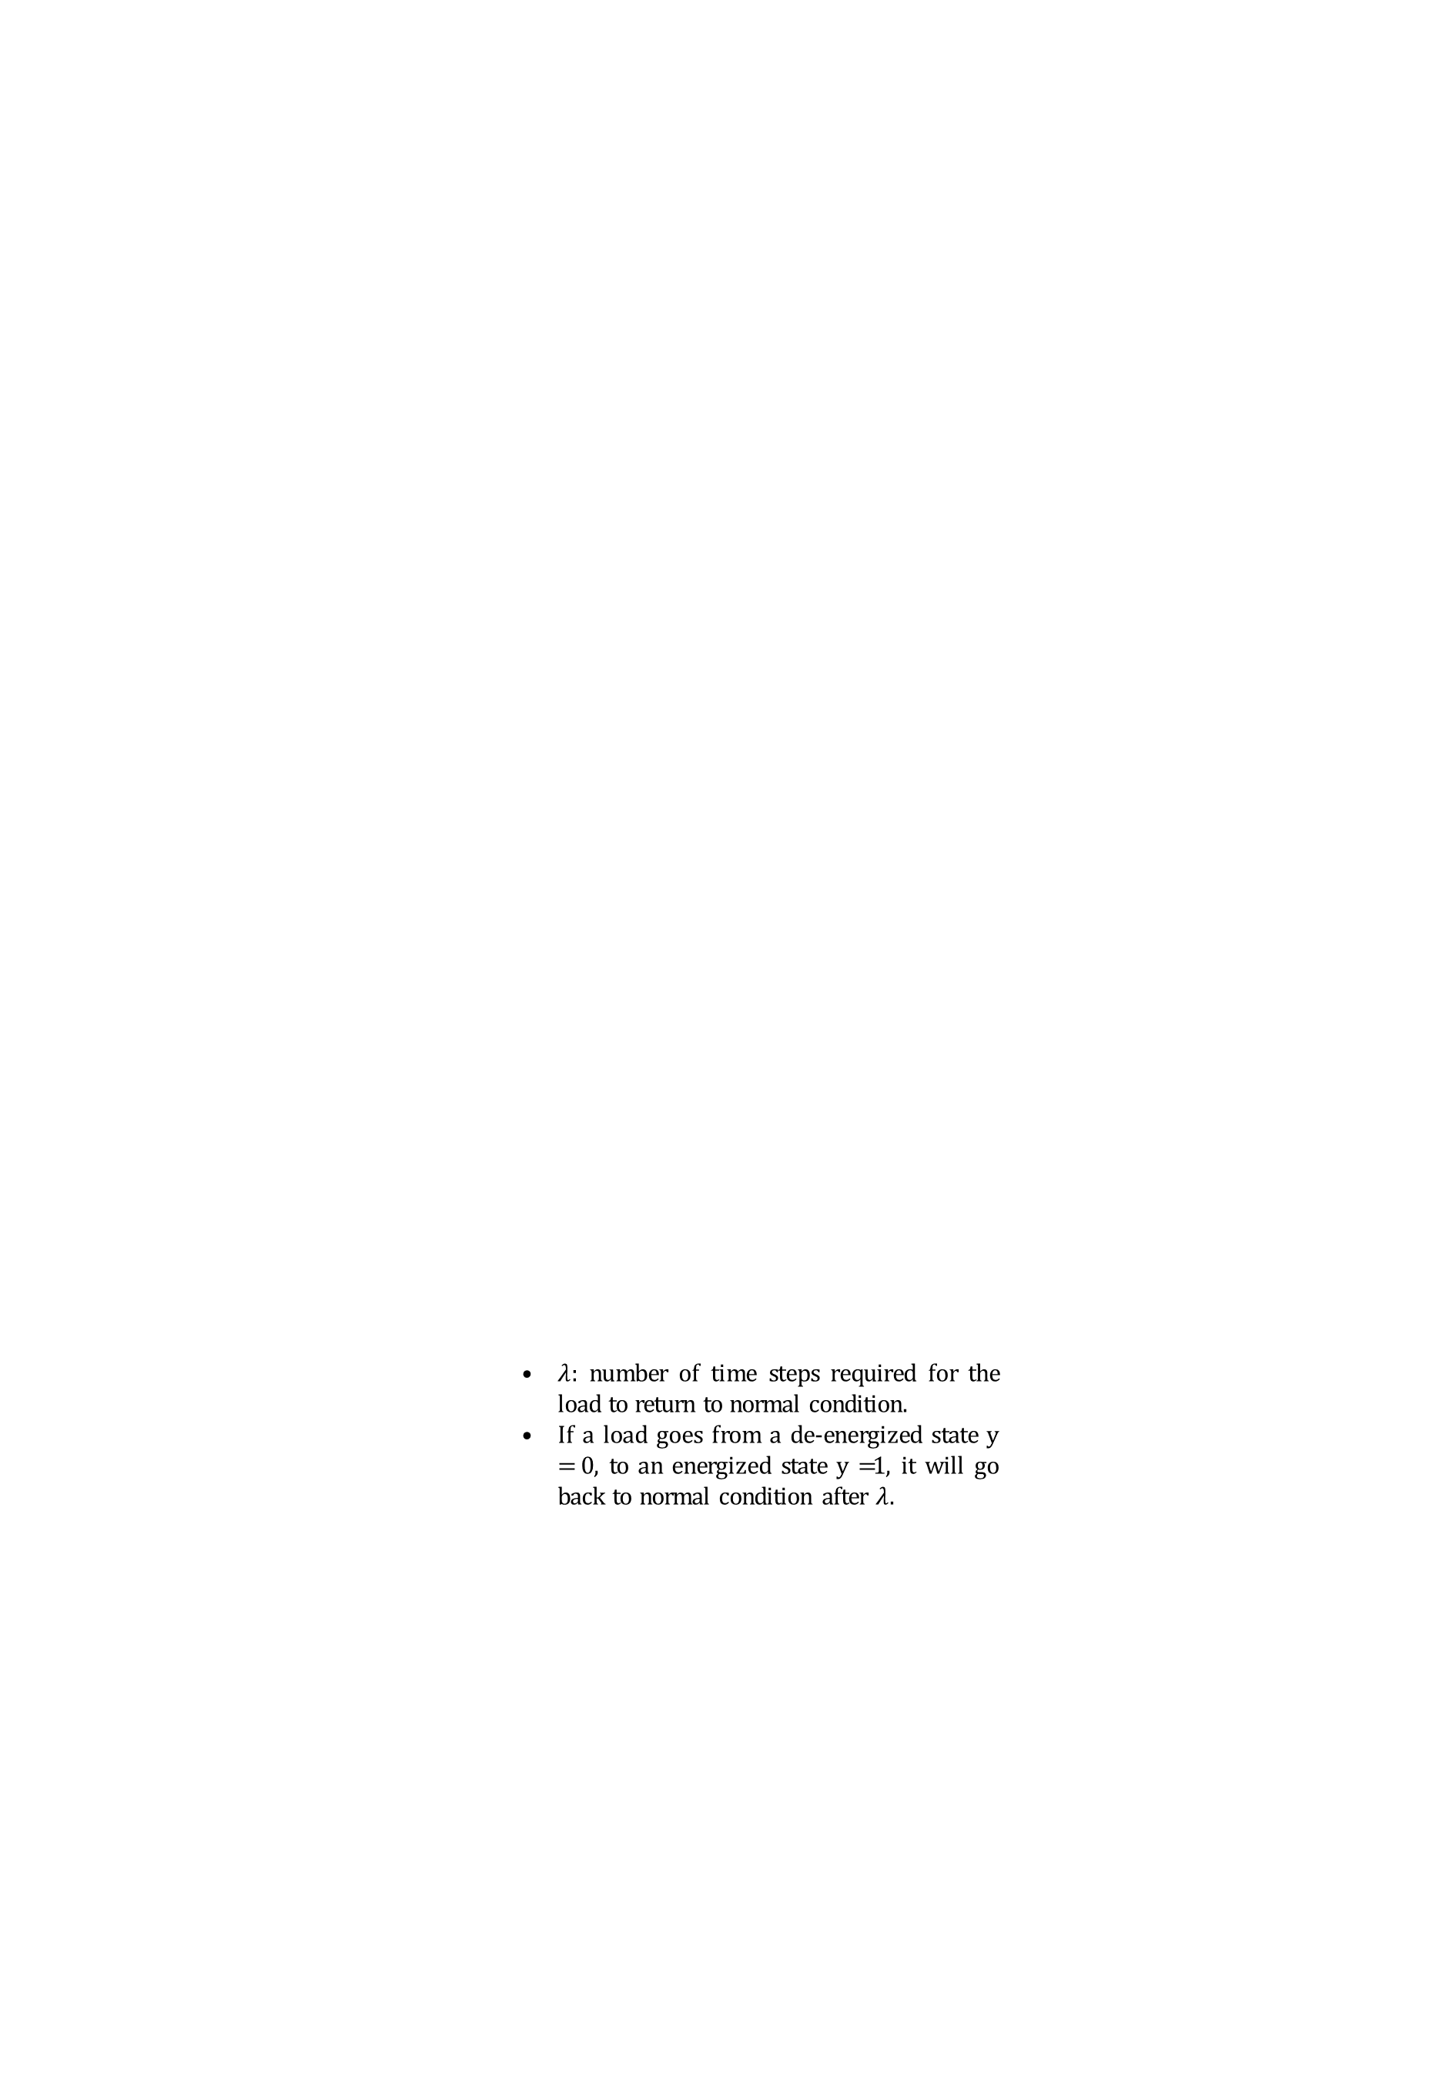
Cold-Load Pickup
Cold load pickup (CLPU) is the well-known problem defined as excessive inrush current drawn by loads when the distribution circuits are re-energized after extended outages.
The typical behaviour of CLPU can be represented using a delayed exponentially decaying function.
We use two blocks to provide a conservative approach and guarantee the supply-load balance (Liu, PSERC 2009).
$λ:$ number of time steps required for the load to return to normal condition.
If a load goes from a de-energized state y = 0, to an energized state y =1, it will go back to normal condition after $λ$.
ECpE Department

Slide 48
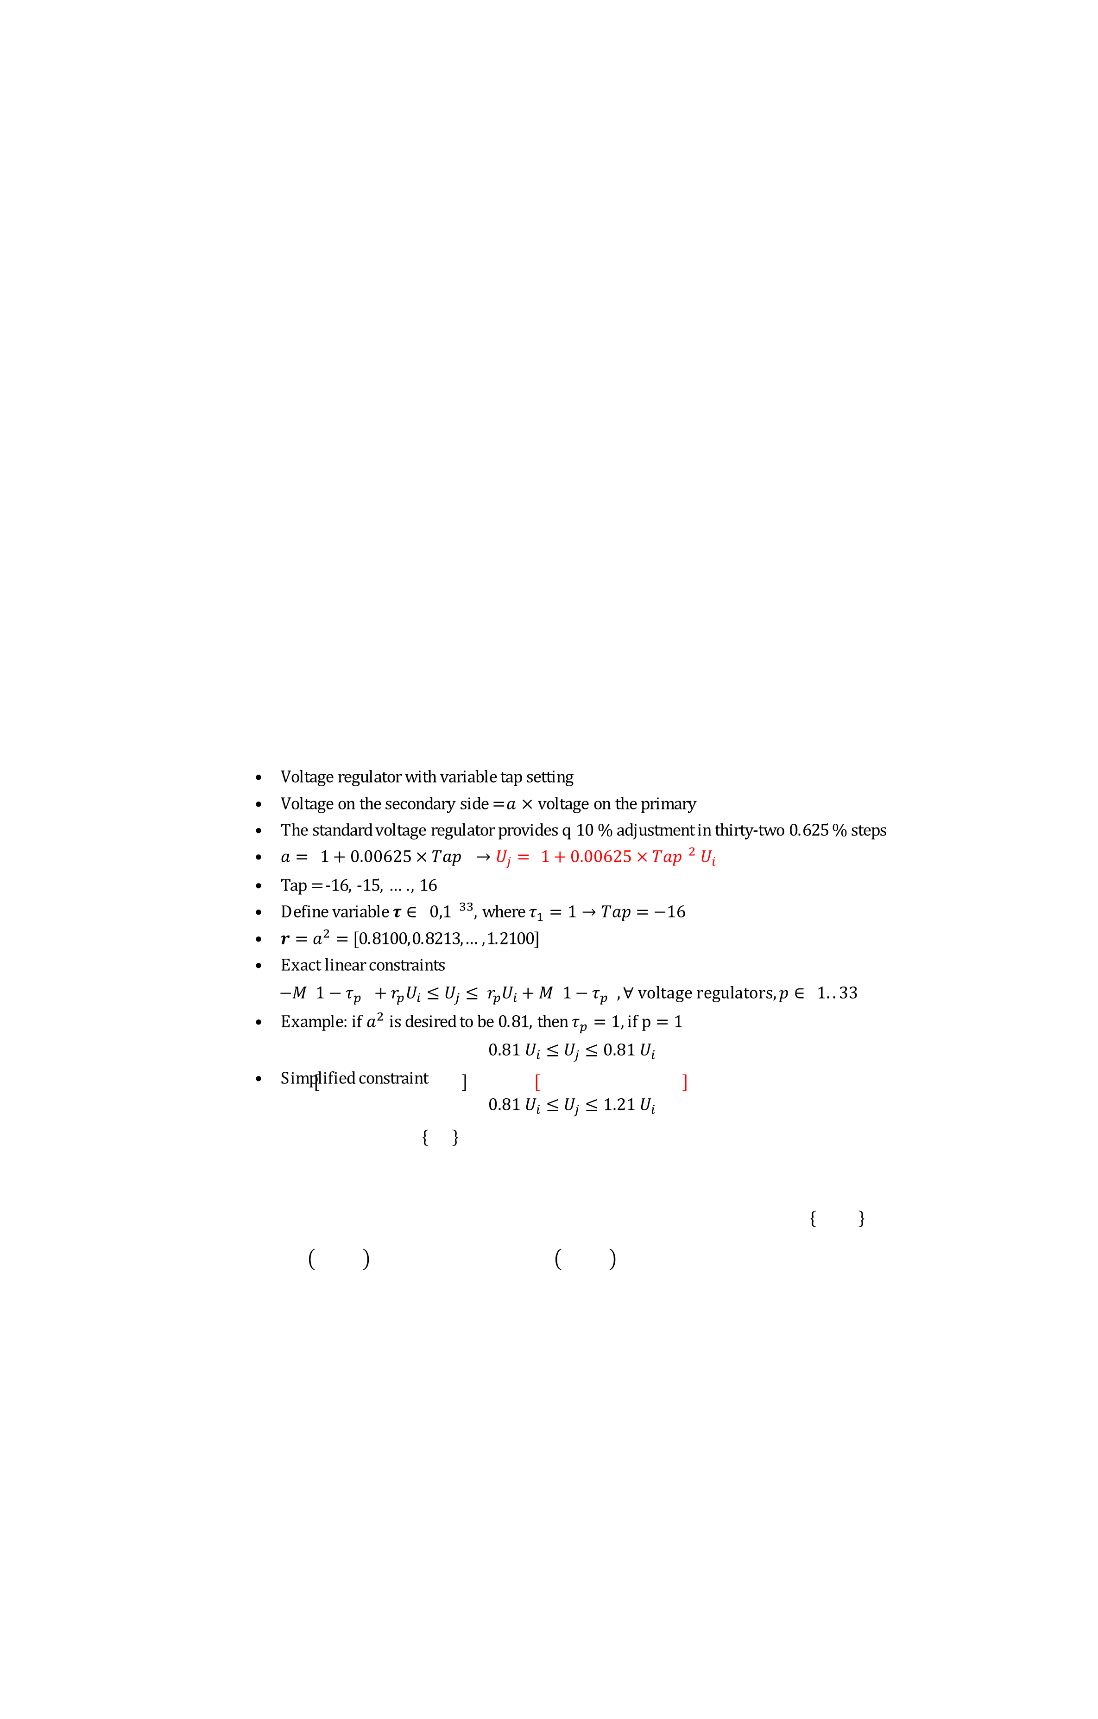
Voltage Regulator
Voltage regulator with variable tap setting
Voltage on the secondary side = $a$ $×$ voltage on the primary
The standard voltage regulator provides ± 10 % adjustment in thirty-two 0.625 % steps
$a=\left[1+0.00625×Tap\right] →U_{j}=$ ${\left[1+0.00625×Tap\right]}^{2} U_{i}$
Tap = -16, -15, …., 16
Define variable $τ∈{\left\{0,1\right\}}^{33}$, where $τ_{1}=1→Tap=−16$
$r=a^{2}=$ [0.8100,0.8213,…,1.2100]
Exact linear constraints
$$−M\left(1−τ_{p}\right)+r_{p}U_{i}≤U_{j}≤ r_{p}U_{i}+M\left({1−τ}_{p}\right), ∀ voltage regulators,p∈\left\{1..33\right\}$$
Example: if $a^{2}$ is desired to be 0.81, then $τ_{p}=1, if p=1$
$$0.81 U_{i}≤U_{j}≤0.81 U_{i}$$
Simplified constraint
$$0.81 U_{i}≤U_{j}≤1.21 U_{i}$$
ECpE Department

Slide 49
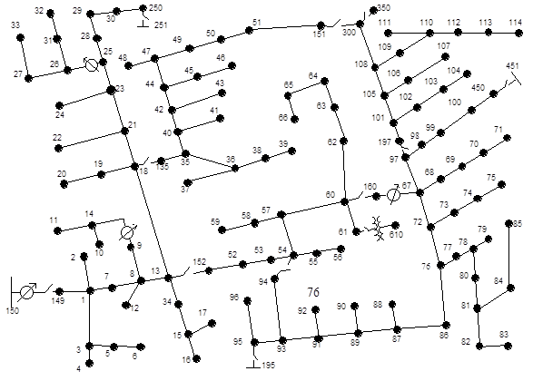


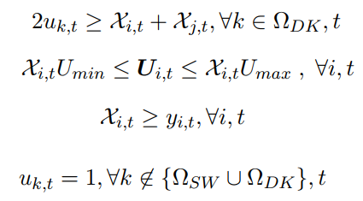
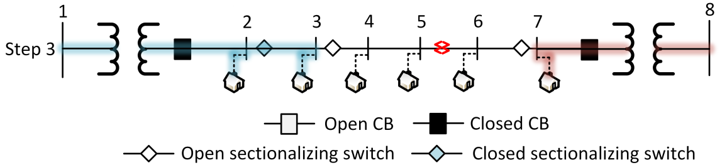
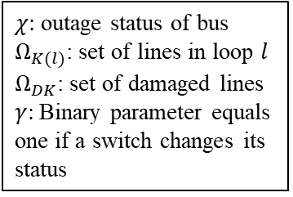
Reconfiguration
Radiality constraints (for radial networks)
Count switching operations
Fault Isolation:
  Force the voltage to be zero on damaged lines
  The voltage propagates through KVL until a CB/switch stops the propagation
(Borghetti 2012)
1
1
0
0
0
$χ:$ outage status of bus
$Ω_{K(l)}$: set of lines in loop $l$
$Ω_{DK}$: set of damaged lines
$γ:$Binary parameter equals one if a switch changes its status
ECpE Department

Slide 50
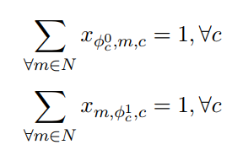
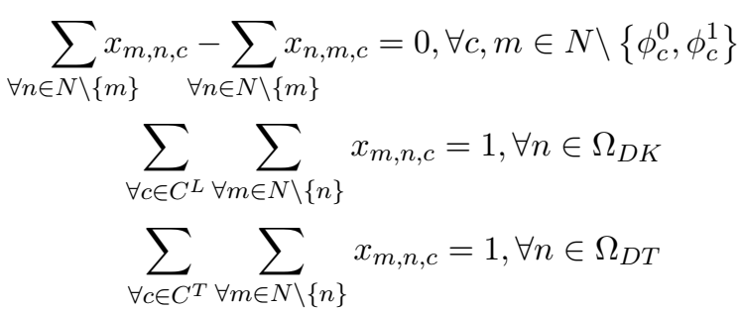

Crew Routing (1/2)
Vehicle routing problem (VRP)
Starting and ending locations
Path-flow constraint
A damaged component is visited only once by a line crew and a tree crew (if required)
Valid route
$x:$binary var equals 1 if crew travels the path
$φ^{0/1}:$ start/return location time
$N$: set of nodes
$Ω_{DT}$: set of lines damaged by trees
$C^{L/T}:$ set of line/tree crews
ECpE Department

Slide 51








Crew Routing (2/2)
  Calculate arrival time
    $Arrival_{n}$= $Arrival_{m}$+$Travel_{mn}$+$Repair_{m}$
  Tree crews must finish before the line crews start repairing
  Set arrival time = 0 (empty) if a crew does not visit a component
1
2
  Crews must have enough equipment to repair the components
  Each crew has a capacity
  Equipment are used/picked up as the crews travel between components
    Equipment on hand = equipment at previous location – equipment used
  The equipment is taken from the depot/warehouse
3
4
5
$α:$ arrival time
$T$: repair time
$tr$: travel time
$Res^{C}$: number of resources a crew takes from a depot
$Res^{D}$: number of resources in the depot
$Cap^{r}$: capacity required to carry an equipment
$Cap^{C}:$ capacity of the crew
$E$: number of resources a crew has at location
$R$: required resources to repair a damaged component
6
7
ECpE Department

Slide 52




Connecting Operation and Routing
When can we operate the component?
  Define binary variable $f$ which equals 1 once the line is repaired
  Calculate the restoration time (Arrival time + Repair time)
  Set the status of the line $(u_{k,t})$ to 1 once the line is repaired
ECpE Department

Slide 53


Challenges
VRP is NP-hard, obtaining the optimal solution for large cases is very challenging.
VRP is commonly solved using heuristic methods.
Combining VRP with distribution system operation highly increases the complexity.
Large number of damages:
    Routing becomes extremely difficult
    E.g. 30 damaged components and 10 crews:
$x_{m,n,c}→30 ×30×10$ =
→ 9000 integer variables for routing only
Computation time is critical!
ECpE Department

Slide 54

Proposed Solution Algorithms
Direct method
  Use commercial solvers (e.g., CPLEX, GUROBI) to solve the mathematical model
Priority-based
Cluster-based (C-DSRRP)
Assignment-based (A-DSRRP)
A-DSRRP $→$Neighborhood Search
ECpE Department

Slide 55


Priority-based
The goal of this method is to mimic the approach used in practice
Define the priority of the lines
  1. Repair lines connected to high-priority customers.
  Weight factor $W_{1}=10$
  2. Repair 3-phase lines.
  Weight factor $W_{2}=5$
  3. Repair single phase lines and individual customers.
  Weight factor $W_{3}=1$
Identify the lines that must be repaired to restore high-priority customers.
  min{(number of lines to repair)| s.t. operation constraints}
Solve the crew routing problem
  min{($\sum_{∀p}{\sum_{k∈L_{p}}{\sum_{{c∈C}^{L}}{W_{p}}α_{c,k}}}$)| s.t. routing constraints}
$L_{p}:$set of lines to repair with priority p
ECpE Department

Slide 56

Cluster-based
Cluster the damaged components to depots.
  min {(distance between depots and components)| s.t. resource constraint}
C-DSRRP
  Solve DSRRP with the crews routed based on the clusters.
VRP problem $→$Multi-VRP subproblems
ECpE Department

Slide 57

Assignment-based
Assign the damaged components to crews.
  min {(distances between components that are assigned to the crews)|
  s.t. resource constraint and assignment constraints}
A-DSRRP
  Solve DSRRP with the crews routed based on the assignments.
VRP problem $→$Multi-TSP subproblems
ECpE Department

Slide 58



Reoptimization (A-DSRRP → Large Neighborhood Search)
Select $ss$ nodes (damaged components)
Remove part of the route connected to the selected components
Set rest of the route to be constant
Solve the optimization problem DSRRP (with warm start and limit 120 s)
Repeat until we reach the stopping criteria (increase $ss$ after $count$ iterations without change)
Update the route once new information is obtained
ECpE Department

Slide 59
Algorithm
Use assignment-based approach
Subproblem I:
  Assign the damaged components to the crews
  Consider uncertainty of the repair times
  Solve using the extensive-form
Subproblem II
  Solve stochastic DSRRP with the crews dispatched to the assigned damaged components
  Use Progressive Hedging to solve the stochastic DSRRP model
ECpE Department

Slide 60

Test Case
Modified IEEE 123-bus distribution feeder.
7 dispatchable DGs and 18 new switches are installed.
Loads at buses 30, 48, 49, 53, 65, and 76 are critical loads.
3 depots, 6 line crews, and 4 tree crews.
14 damaged lines.
Repair times
  Intensity of the damage is represented by the repair time.
  Repair time is generated using a truncated lognormal distribution (Z. Zhu 2012).
Time limit 3600 seconds (Van Hentenryck 2011).
Solved using AMPL-CPLEX.
ECpE Department

Slide 61

Simulation Results-Reoptimization
Objective: $148,185
Energy served = 62,436 kWh
All loads are served after 9 hours
Iterations: 27
Computation time: 3120 seconds
ECpE Department

Slide 62
Simulation Results-Reoptimization (Cont.)
After 2 hours
After 4 hours
ECpE Department

Slide 63

Solution Comparison
ECpE Department

Slide 64

Optimality Gap
Using the Reoptimization solution as an initial solution (warm start), the complete DSRRP problem is solved using CPLEX.
Out of memory after approximately 4 hours.
Solution did not change, optimality gap is 4.28%
ECpE Department

Slide 65



Test Case
Modified IEEE 123-bus distribution feeder.
9 DGs and 23 switches
3 depots, 6 line crews, and 4 tree crews.
14 damaged lines
The model and algorithm are implemented in AMPL, with CPLEX solver
ECpE Department

Slide 66



Results: Solution Comparison
Optimal solution is obtained by using the Reoptimization solution to warm-start CPLEX and solve the complete method
ECpE Department

Slide 67


Results: Route Comparison
Reoptimization (optimal) route
Priority-based route
ECpE Department

Slide 68




Simulation Results-Reoptimization
After 3 hours
After 4 hours
ECpE Department

Slide 69

Results: Reoptimization
Objective value: $199,210
Iterations: 21
Computation time: 694 seconds
ECpE Department

Slide 70

Results: DGs and Switches
To show the importance of DGs and automatic switches, we vary the number of DGs and switches for the 14 damage case
The best performance is obtained with the highest number of DGs and switches, as expected
Switches are needed so that the DGs reach their full potential
ECpE Department

Slide 71


Test Case: IEEE 8500-bus
Reoptimization: $763,184
Priority-based: $849,842
ECpE Department

Slide 72
Method 2: Two-Stage Stochastic MILP
Uncertainty
  Repair time (Zhu 2012)
  Demand (Lu 2013)
  Solar irradiance (Torquato 2014)
Objective
  Minimize cost of shedding loads and switching operation
First-stage constraints
  Dispatch repair crews
  Equipment constraints
Second-stage constraints
  Distribution system operation
  Arrival time constraints
  Connect crews routing and power operation
ECpE Department

Slide 73


Uncertainty
Repair time: lognormal distribution (Zhu 2012)
Demand: truncated normal forecast error distribution (Lu 2013)
Solar irradiance: cloud coverage level and normal distribution (Torquato 2014)
Repair time
Damage | Scenario 1 | Scenario 2 | Scenario 3 | … | Scenario S
Line 1 | 2.71 | 3.61 | 1.97 | … | 3.11
Line 2 | 4.01 | 2.36 | 3.85 | … | 5.11
Line 3 | 1.24 | 3.21 | 1.06 | … | 4.62
Line 4 | 1.5 | 1.87 | 2.88 | … | 3.45
. . . | . . . | . . . | . . . | . . . | . . .
Line D | 1.68 | 1.84 | 4.69 | … | 2.46
ECpE Department

Slide 74






Stochastic DSRRP
ECpE Department

Slide 75


Stochastic vs Deterministic
Solve the 14 damaged lines test case using:
  Stochastic method (DS-DSRRP) $→$ consider different scenarios $ξ$ $→$ obtaine route $x^{S}$
  Static-Reoptimizaton $→$ consider average scenario $→$ obtain route $x^{R}$
  Dynamic-Reoptimizaton $→$ consider average scenario $→$ obtain route $x^{D}$ $→$ update if the repair time changes
Set the routes as constant (not for the dynamic method)
Generate a new scenario $ξ_{case}$ for the repair times to be the actual realization and calculate the objective value
ECpE Department

Slide 76
Conclusions
Effective preparation procedures can ensure that enough equipment is present for repairing the damaged components in the network and facilitate a faster restoration process
Co-optimizing repair and recovery operation leads to better results compared to solving the two problems separately
Efficient repair schedule along with DGs and controllable switches limit the outage size and can decrease the restoration time
Advanced solution algorithms are required for solving the co-optimization problem due to its complexity
A dynamic approach where the deterministic solution is periodically updated can achieve better solutions than stochastic programming
ECpE Department

Slide 77
Publications
Journal Papers
A. Arif, Z. Wang, J. Wang, and C. Chen, “Repair and resource scheduling in unbalanced distribution systems using neighborhood search,” IEEE Trans. Smart Grid, Under Review.
A. Arif, Z. Wang, C. Chen, B. Chen, “A stochastic multi-commodity logistic model for disaster preparation in distribution systems,” IEEE Trans. Smart Grid, to be published.
A. Arif, S. Ma, Z. Wang, J. Wang, S. M. Ryan and C. Chen, “Optimizing service restoration in distribution systems with uncertain repair time and demand,” IEEE Trans. Power Syst., vol. 33, no. 6, pp. 6828-6838, Nov. 2018.
A. Arif, Z. Wang, J. Wang, B. Mather, H. Bashualdo, and D. Zhao, “Load modeling - a review,” IEEE Trans. Smart Grid, vol. 9, no. 6, pp. 5986-5999, Nov. 2018.
A. Arif, Z. Wang, J. Wang, and C. Chen, “Power distribution system outage management with co-optimization of repairs, reconfiguration, and DG dispatch,” IEEE Trans. Smart Grid, vol. 9, no. 5, pp. 4109-4118, Sept. 2018.
A. Arif and Z. Wang, “Networked microgrids for service restoration in resilient distribution systems,” IET Gener. Transm. Distrib., vol. 11, no. 14, pp. 3612-3619, Sep. 2017.
Conference Paper
S. Ma, S. Li, Z. Wang, A. Arif, K. Ma., “A novel MILP formulation for fault isolation and network reconfiguration in active distribution systems,” IEEE PES General Meeting, Portland, OR, 2018, pp. 1-5.
A. Arif, Z. Wang, “Distribution network outage data analysis and repair time prediction using deep learning,” IEEE Int Conf. Probabilistic Methods Appl. Power Syst., Boise, ID, 2018, pp. 1-6.
A. Arif, S. Ma, Z. Wang, “Dynamic reconfiguration and fault isolation for a selfhealing distribution system,” IEEE PES Transm. Distrib. Conf. Expo., Denver, CO, 2018, pp. 1-5.73
A. Arif, S. Ma, Z. Wang, “Online decomposed optimal outage management after natural disasters,” IEEE PES General Meeting, Chicago, IL, 2017, pp. 1-5.
A. Arif, S. Ma, Z. Wang, “Optimization of transmission system repair and restoration with crew routing,” IEEE North Amer. Power Symp., 2016, Denver, CO, pp. 1-6.
A. Arif and Z. Wang, “Service restoration in resilient power distribution systems with networked microgrid,” IEEE PES General Meeting, Boston, MA, 2016, pp. 1-5.
ECpE Department

Slide 78
Part III Resilience-oriented Long-term Planning
ECpE Department

Slide 79
Outline
Motivation and Introduction
Problem Statement
Literature Review
Research Objectives and Contributions
Stochastic Decision Process
Mathematical Formulation
Solution Algorithms
Simulation and Results
Conclusions and Future Work
ECpE Department

Slide 80




Motivation: Impacts of Extreme Weather Events
Extreme weather event
Distribution Grids
The probability of occurrence
The failure frequency
Climate Change
The intensity
The power outages
(Hurricane, ice-storm, flood, etc)
Example: Hurricane Irma in September 2017
  Left 6.7 million Floridians without power-65% of all customers in Florida [1]
  Its overall damage cost reached to approximately 50 billion [2]
Power poles pulled down by Irma^{[3]}
South Florida Night before Irma ^{[5]}
South Florida Night After Irma ^{[5]}
South Florida Night After Irma ^{[5]}
Substation flooded by Irma ^{[4]}
ECpE Department

Slide 81
Motivation: Current Situation of Distribution Systems
Most existing distribution systems are designed and maintained for normal weather conditions
The classic reliability principles cannot guarantee the lights on under extreme weather events
U.S. power grids are now old and outdated
Utilities upgrade grids based on experiences, patrols, and observations
As power engineers, how can we improve grid resilience to survive from extreme weather events?
ECpE Department

Slide 82

Introduction: The Resilience of Distribution System
A distribution system is considered to be resilient if it is able to anticipate, absorb, adapt to, and/or rapidly recover from a disruptive event [6].
Event prevention stage: Resistant capability
Damage propagation stage: Absorptive
and adaptive capacity
Restoration stage: Recovery capability
Fig.1. A general system performance curve of a distribution system following an extreme weather event
ECpE Department

Slide 83
Introduction: The Resilience Enhancement Measures
Two resilience goals of distribution systems [7]:
System adaptation (to reduce the impact of future events)
System survivability (to maintain an adequate functionality during and after the event)
Resilience enhancement measures:
Resilience-Oriented Design (ROD) Measures
Resilience-Oriented Operational (ROO) Measures
Disaster Response
& Risk Management
Topological and structural upgrades of the utility’s infrastructures
  Upgrading distribution poles to stronger class
  Installing automatic switches
  Installing back-up distributed generators (DG)
“Smart” control-based actions
  Network reconfiguration
  DG rescheduling
  Conservation voltage regulation
  Defensive islanding
  Microgrid-assisted control actions
  Priority-based load shedding
ECpE Department

Slide 84



Introduction: The Big Picture
A resilient distribution system
  Planning: pole hardening, and DG and switch installation
  Operation: co-optimization of repair scheduling and restoration operation
We focus on exploring effects of ROD measures on system resilience with the consideration of operation response
ECpE Department

Slide 85
Problem Statement
How to optimally apply ROD measures to prevent distribution system from extensive damages caused by extreme weather events
  Some spatial-temporal correlations exist among ROD decisions, extreme weather events, and system operations
    Occurrence, intensity and traveling path of events are uncertain
    Physical infrastructure damage status are affected by both extreme weather event and ROD decisions
    ROD decisions affect system recovery and the associated outage/repair costs
  A time-varying interaction exists between structural damages and electric outage propagation
Difficult to capture the entire failure-recovery-cost process of distribution systems during and after an extreme weather event.
ECpE Department

Slide 86
Literature Review
Ref | Uncertainty Consideration | Measures | Model/Algorithm
[8] | Use a polyhedral set to represent damage uncertainty | line hardening | Robust optimization/column-and-constraint generation algorithm
[9] | Use failure probabilities of distribution lines to represent damage uncertainty set | Pole hardening Vegetation management Combination of both | Tri-level robust optimization/greedy algorithm
[10] | Use failure probabilities of overhead lines and underground gas pipelines to generate line damage uncertainty set | Line hardening | Tri-level robust optimization/column-and-constraint generation algorithm
[11] | Use fragility model to generate line damage uncertainty | Line hardening DG placement Switch Installation | Two-stage stochastic program/a scenario-based variable neighborhood decomposition search algorithm
[12] | Use fragility model to generate line damage uncertainty | Line hardening (replace overhead line with underground line) MGs Networked MGs | Two-stage stochastic program/a decomposition-based heuristic algorithm
[13] | Use fragility model to generate line damage uncertainty Model repair time uncertainty Consider load demand uncertainty | Line hardening DG placement Switch Installation | Two-stage stochastic program/Progressive hedging algorithm
ECpE Department

Slide 87
Research Objective
Develop a new modeling and solution methodology for the ROD of distribution systems against wind-induced extreme weather events
Develop a hybrid stochastic process with a deterministic casual structure to describe the spatio-temporal correlations of ROD decisions and uncertainties
Formulate a two-stage stochastic mixed-integer linear program (SMILP) to capture the impacts of ROD decisions and uncertainties on system’s responses to extreme weather events
Design solution algorithm for solving the above problems.
ECpE Department

Slide 88
Research Contributions
Model a hybrid independent stochastic process with a deterministic causal structure to capture the spatiotemporal correlation among the various uncertainties and ROD decisions
  avoid establishing the high-dimension joint distribution of uncertain variables
  model the evolving impacts of extreme weather events on physical infrastructures
Propose a two-stage SMILP to optimally implement multiple ROD measures considering various uncertainties, thus increasing the infrastructure strength and enabling self-healing operations
  captures the entire failure-recovery process
  the self-healing operation in the second stage can mimic the outage propagation with minimum service interruption
Develop a customized DD algorithm to balance optimality and solution efficiency
ECpE Department

Slide 89
Stochastic Decision Process of ROD Problem
Overview
First-stage decisions
Uncertainty Modeling
ECpE Department

Slide 90

Overview
ROD problem is modeled as a two-stage stochastic decision process:
  Planner makes ROD decisions
  The operation uncertainties are resolved during the extreme weather event
  Operator makes the recourse decisions
ECpE Department

Slide 91

First-Stage Decisions
Hardening poles:
  Strengthening vulnerable components
  Consider 6 pole types
  Pole stress
Fig.1. Pole types
Installing Backup DGs
  Increasing adequacy of power supply
Adding sectionalizers
  Increasing topological flexibility
  Can be added at both ends of a line
ECpE Department

Slide 92

Uncertainty Modeling
Consider three groups of random variables that have direct impacts on the evolution of the system operation state
  Line damage status
  Repair costs
  Load demands
Fig.1. The structure of uncertainty space: independent observable random variables/processes (highlighted in red) + deterministic casual connections (parameterized by the first-stage decision).
ECpE Department

Slide 93

(a) Line Damage Status Uncertainty
Pole hardening decision
Structural limit state function (G)
=Pole resistance (R) – Wind load (S)
Wood fiber stress
Wind speed
ECpE Department

Slide 94

(b) Repair Cost Uncertainty
Pole hardening decision
Pole repair cost
Structural limit state function (G)
=Pole resistance (R) – Wind load (S)
Wood fiber stress
Wind speed
ECpE Department

Slide 95



(c) Load Demand Uncertainty
Fig.1. load demand uncertainty
Fig.2. load profile shape at the substation (root node)
ECpE Department

Slide 96
Mathematic Formulation of ROD Problem
Overview
First-stage Problem
Second-stage Problem
ECpE Department

Slide 97

Overview
Investment Stage: identify the optimal ROD decisions
Operation Stage: achieve self-healing operation
  need a mathematic formulation to fully model power outage propagation
  need an analytic optimization to sectionalize a distribution network into multiple self-supplied MGs while maintaining their radial network typologies
ECpE Department

Slide 98







First-Stage Formulation
Objective:
Minimize the ROD investment cost and the expected cost of the loss of load, DG operation, and damage repair in realized extreme weather events
First stage ROD variables:
whether hardening line (1) or not (0)
whether adding a sectionalizer at the end of line (1) or not (0)
whether installing DG at node (1) or not (0)
First stage constraints:
Hardening strategy limit
DG number limit
Switch installation constraint
The expected cost of the second stage
ECpE Department

Slide 99


Second-Stage Problem: Technique Outline (1)
Model the power outage propagation (expressed by a set of constraints)
Add a virtual node in the middle of each branch
Apply a symmetric fault to the virtual node if the line is damaged
Set the voltage feasible region:
Fig.1. The illustrative example for isolating a fault
Fully curtail a load when its voltage magnitude is zero
Set loading limits to all branches and penalize load shedding amount in the objective
ECpE Department

Slide 100



Second-Stage Problem: Technique Outline (2)
Radiality Constraints for each energized networks
Graph Theorem [14]: A forest of nodes has exactly edges, where is the number of connected network components.
How to obtain in the distribution system
Calculate by counting the degree of freedom of voltage angles
Formulate a virtual DC optimal power flow (VDCOPF) sub-problem to obtain this degree of freedom
the optimal solution of this sub-problem satisfies that the virtual loads in the same energized island are nearly equally distributed at active nodes
each energized island has and only has an active node with zero angle
The radiality constraint is satisfied iff the number of active branches equals the total number of active nodes minus the number of active nodes with zero angles
ECpE Department

Slide 101
Second-Stage Formulation
Objective
  Minimize the cost of the loss of load, DG operation, and damage repair in a realized extreme weather event given ROD decisions
Constraints
  Distribution system operation
    Line damage status constraint
    Line repair cost constraint
    Line’s on-off status constraints (controlled by switch’s on-off status)
    Line flow limits (controlled by line’s on-off status)
    Linearized DistFlow equations (calculate power flow and voltage profile)
    DG capacity limits
  Fictitious faulting logic constraints (model outage propagation)
    Virtual node power injection constraints
    Voltage magnitude limits
    Load shedding ratio limit
The minimality condition of VDCOPF sub-problem (obtain the degree of freedom of voltage angle)
  Zero Angle indicator constraint (indicating a node with zero angle)
ECpE Department

Slide 102
Key Points
Information passing:
Line’s on-off status and DG on-off status
Second-stage problem
VDCOPF sub-problem
Optimal virtual voltage angle
Fictitious faulting logic constraints +Distribution system operation constraints in 1)-3) + Penalty cost of load shedding in objective：
  isolate damaged lines while minimizing the de-energized network parts
  make network constraints such as power flow automatically adapt to the topology after reconfiguration
Radiality Constraints + Zero angle indicator constraint + VDCOPF sub-problem
  can keep each energized network radial
ECpE Department

Slide 103








Distribution System Operation Constraints
1
Line damage status constraint
2
Line repair cost constraint
3
Line’s on-off status constraints
Line flow limits
Linearized DistFlow equations
4
DG capacity limits
Binary variables:
Line damage status
Sectionlizer on-off status
Line on-off status
5
6
105
ECpE Department

Slide 104




Fictitious Faulting Logic Constraints
Virtual node power injection constraints
1
Voltage magnitude limits
2
Load shedding ratio limit
3
Radiality constraints
1
Radiality constraint
Active branch identification constraint
2
Zero angle indicator constraint
Binary variables:
active node active branch
node with zero voltage angle
ECpE Department

Slide 105





The Minimality Condition of VDCOPF Sub-problem
To realize that a connected network component (healthy MG) has one and only one degree of freedom of voltage angle under the condition of full DC power flow equations
KKT optimality condition:
ECpE Department

Slide 106




Dual Decomposition Algorithm
A Compact Notation Form of ROD Model
where
To induce a scenario-based decomposable structure, the copies of the first-stage variables x are introduced to create the following reformulation
The Lagrangian relaxation with respect to the nonanticipativity constraint
The lower bound of the Lagrangian relaxation:
ECpE Department

Slide 107



Case Study
The IEEE 123-bus system is mapped into a coastal city in Texas.
The repair cost of a single pole for 6 pole types is assumed to be the same
Consider the budget limitation, the total number of backup DGs is limited to be 5
Fig.1. The optimal ROD methods implementation
The total investment cost is $5, 048,000
ECpE Department

Slide 108

Simulating A Pole Damage Status in A Hurricane
ECpE Department

Slide 109

Case1: Comparison with and without ROD
Compare the second stage cost from the hurricane hits the system to the point when all damaged lines are repaired
Fig.1. The second stage cost comparison with and without ROD under different scenarios
The expected second-stage cost with optimal ROD is 8.93% of that without ROD
ECpE Department

Slide 110


Case1: Comparison with and without ROD
Compare the system resilience by the resilience curve, which can be expressed by the percentage of power-served (POPS(t)):
Fig.1. The system resilience curve comparison
The system with optimal ROD has stronger surviving ability to withstand hurricane and faster recovery
DGs and automatic sectionalizers can contribute to mitigating the hurricane’s impact on the system
ECpE Department

Slide 111


Case2: The Self-healing Operation Case
To validate the novelty of our MILP formulation strategy to solve the challenges of self-healing operation
Fig.1. System’s self-healing operation at t = 10
Fig.2. System’s self-healing operation at t = 21
ECpE Department

Slide 112
Conclusions
A new modeling and solution methodology for resilience-oriented design (ROD) of power distribution systems against wind-induced climatic hazards is proposed
  The spatial-temporal correlations among ROD decisions, uncertainty space, and system operations during and after extreme weather events are well explored and established
  A two-stage stochastic mixed-integer model is proposed with the objective to minimize the investment cost in the first-stage and the expected costs of the loss of loads, repairs and DG operations in the second stage.
  A scenario-based dual composition algorithm is developed to solve the proposed model
  Numerical studies on the 123-bus distribution system demonstrate the effectiveness of optimal ROD on enhancing the system resilience
ECpE Department

Slide 113

Future Work
We focus on the resource allocation problem ahead of an upcoming extreme weather event
consider the uncertainty of the damaged line status, solar irradiance, load demand, and crew repair time
explore a tractable measure to model the risk associated with grid components’ damages caused by extreme weather events
ECpE Department

Slide 114
Publications
Journal Papers
S. Ma, S. Li, Z. Wang, and F. Qiu, “Resilience-Oriented Distribution System Design with Decision-Dependent Uncertainty,” IEEE Transactions on Power System, accepted, 2019.
S. Ma, Z. Wang, and L. Tesfatsion, “Swing Contracts with Dynamic Reserves for Flexible Service Management,” IEEE Transactions on Power System, accepted, 2018
S. Ma, L. Su, Z. Wang, and F. Qiu, “Resilience Enhancement of Distribution Grids Against Extreme Weather Events,” IEEE Transactions on Power System, vol. 33, no. 5, pp. 4842-4853, Sept. 2018.
A. Arif, S. Ma, Z. Wang, J Wang, S. M. Ryan, and C. Chen, “Optimizing Service Restoration in Distribution Systems With Uncertain Repair Time and Demand,” IEEE Transactions on Power System, vol. 33, no. 6, pp. 6828-6838, Nov. 2018.
S. Ma, B. Chen and Z. Wang, "Resilience Enhancement Strategy for Distribution Systems Under Extreme Weather Events," in IEEE Transactions on Smart Grid, vol. 9, no. 2, pp. 1442-1451, March 2018.
Conference Paper
S. Ma, N. Carrington, A. Arif, and Z. Wang, “Resilience Assessment of Self-healing Distribution Systems Under Extreme Weather Events”, IEEE PES General Meeting, accepted, 2019.
S. Ma, S. Li, Z. Wang, A. Arif, and K. Ma., “A novel MILP formulation for fault isolation and network reconfiguration in active distribution systems,” IEEE PES General Meeting, Portland, OR, 2018, pp. 1-5.
A. Arif, S. Ma, and Z. Wang, “Dynamic reconfiguration and fault isolation for a selfhealing distribution system,” IEEE PES Transm. Distrib. Conf. Expo., Denver, CO, 2018, pp. 1-5.73
A. Arif, S. Ma, and Z. Wang, “Online decomposed optimal outage management after natural disasters,” IEEE PES General Meeting, Chicago, IL, 2017, pp. 1-5.
A. Arif, S. Ma, and Z. Wang, “Optimization of transmission system repair and restoration with crew routing,” IEEE North Amer. Power Symp., 2016, Denver, CO, pp. 1-6.
ECpE Department

Slide 115
Reference
[1] A. L. Tyler Hodge, “Hurricane irma cut power to nearly two-thirds of florida’s electricity customers,” U.S. Energy Information Administration, Tech. Rep., 2017. [Online]. Available: https://www.eia.gov/todayinenergy/detail.php?id=32992
[2] A. B. Smith, “2017 us billion-dollar weather and climate disasters: a historic year in
context,” NOAA Climate. gov [available online at: https://www. climate. gov/newsfeatures/blogs/beyond-data/2017-us-billion-dollar-weather-and-climate-disasters-historic-year,accessed 26 May 2018], 2018.
[3] https://www.cnbc.com/2017/09/11/irma-knocks-out-power-to-nearly-four-million-in-florida-utilities.html
[4] https://www.electric.coop/co-mo-electric-helping-hurricane-irma-repairs
[5] https://www.vox.com/science-and-health/2017/9/11/16290234/hurricane-irma-2017-power-outages-florida-miami-naples-keys-space
[6] A. Gholami, T. Shekari, M. H. Amirioun, F. Aminifar, M. H. Amini, and A. Sargolzaei, “Toward a consensus on the definition and taxonomy of power system resilience,” IEEE Access, vol. 6, pp. 32 035-32 053, 2018
[7] M. Panteli and P. Mancarella, “The grid: Stronger, bigger, smarter?: Presenting a conceptual framework of power system resilience,” IEEE Power Energy Mag., vol. 13, no. 3, pp. 58-66, May 2015.
[8] W. Yuan, J. Wang, F. Qiu, C. Chen, C. Kang, and B. Zeng, “Robust optimization-based resilient distribution network planning against natural disasters,” IEEE Trans. Smart Grid, vol. PP, no. 99, pp. 1-10, 2016.
[9] S. Ma, B. Chen, and Z. Wang, “Resilience enhancement strategy for distribution systems under extreme weather events,” IEEE Trans. Smart Grid, vol. PP, no. 99, p. 1, 2016.
[10] C. He, C. Dai, L. Wu, and T. Liu, “Robust network hardening strategy for enhancing resilience of integrated electricity and natural gas distribution systems against natural disasters,” IEEE Trans. Power Syst., vol. 33, no. 5, pp. 5787{5798, Sep. 2018.
[11] E. Yamangil, R. Bent, and S. Backhaus, “Resilient upgrade of electrical distribution grids,” in Twenty-Ninth AAAI Conference on Artificial Intelligence, Austin, Texas, USA, Jan. 2015, pp. 1233-1240.
[12] A. Barnes, H. Nagarajan, E. Yamangil, R. Bent, and S. Backhaus, “Resilient design of largescale distribution feeders with networked microgrids,” Electric Power Systems Research, vol. 171, pp. 150-157, 2019.
[13] S. Ma, L. Su, Z. Wang, F. Qiu and G. Guo, “Resilience Enhancement of Distribution Grids Against Extreme Weather Events,” IEEE Trans. Power Syst., vol. 33, no. 5, pp. 4842-4853, Sept. 2018.
[14] R. K. Ahuja, T. L. Magnanti, and J. B. Orlin, “Network flows: theory, algorithms, and applications,” 1993.
ECpE Department

Slide 116
Thank You!
Q & A
ECpE Department

